Slide 1
Energy Storage & Cyber Security
EPRI’s Approach
Candace Suh-Lee, CISSP, CISSA
Principal Technical Leader – Cyber Security
csuh-lee@epri.com
April 11
Energy Storage Technologies & Applications Conference, UCR

Slide 2
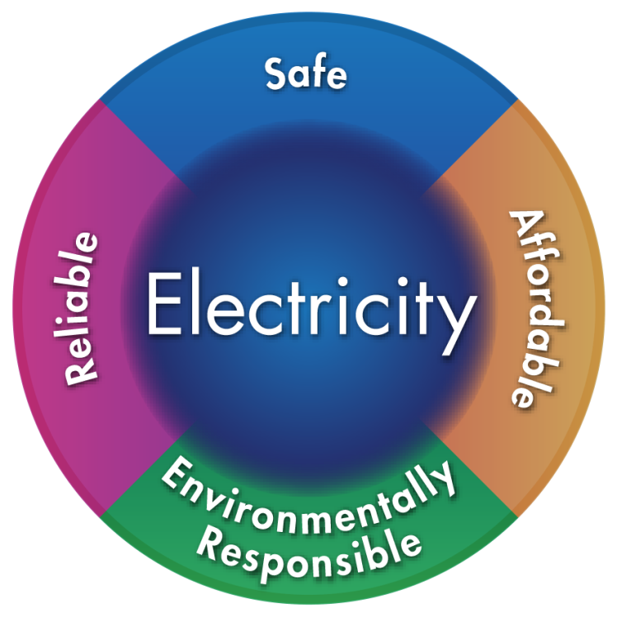
EPRI’s Mission
Advancing safe, reliable, affordable and environmentally responsible electricity for society through global collaboration, thought leadership and science & technology innovation

Slide 3
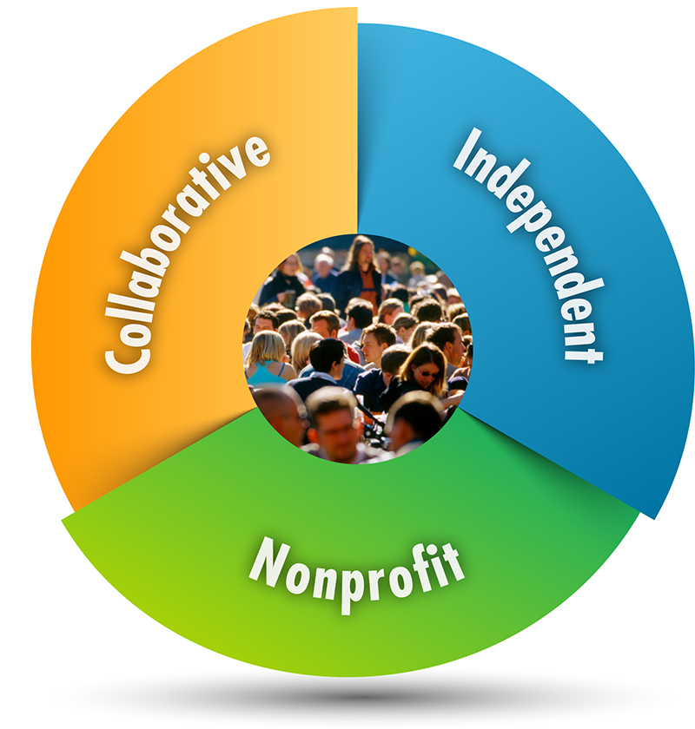
Three Key Aspects of EPRI
Independent & Neutral Objective, scientifically based results address reliability, efficiency, affordability, health, safety, and the environment
Nonprofit Chartered to serve the public benefit
Collaborative Bring together scientists, engineers, academic researchers, and industry experts
Intellectual Leverage
Financial Leverage

Slide 4
Conducting Research Today
Cyber Security Research in 3 EPRI Sectors
Energy and Environment
Environmental Sciences: Air and Multimedia
Strategic Analysis and Technology Assessments
Environmental Sciences: Groundwater and Land Management
Workforce and the Public: Health Assessment and Safety
Environmental Sciences: Water and Ecosystems
Nuclear
Advanced Nuclear Technology
Chemistry, Low-Level Waste and Radiation Management
Equipment Reliability
Fuel Reliability
Long-Term Operations
Materials Degradation/Aging
Nondestructive Evaluation and Material Characterization
Risk and Safety Management
Used Fuel and High-Level Waste Management
Generation
Advanced Coal Plants, Carbon Capture and Storage
Combustion Turbines
Environmental Controls
Major Component Reliability
Materials and Chemistry
Operations and Maintenance
Power Plant Water Management
Renewable Energy
Power Delivery and Utilization
Distribution Utilization
Distribution
Energy Utilization
Information, Communication, and Cyber Security
Transmission
Grid Operations and Planning
Transmission and Substations

Slide 5
Cyber Security Roadmap – Electric Industry Driven
Cyber Security Roadmap for EPRI, Updated December 31, 2018
https://www.epri.com/#/pages/product/000000003002014536/?lang=en-US

Slide 6
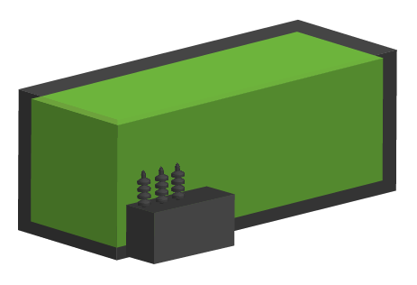
Advancing the integration of energy storage systems through open, technical collaboration
Safe, reliable, cost-effective

Slide 7
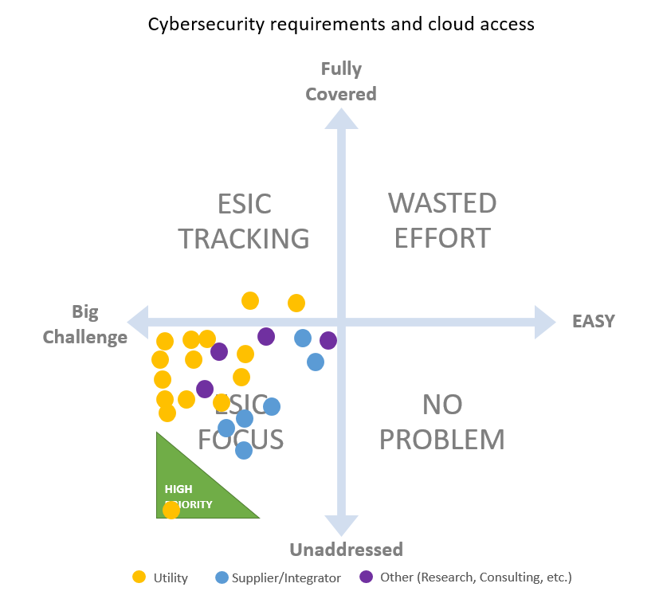
Poll from ESIC Waltham General Meeting: Strong Need Identified for Cybersecurity Guidelines

Slide 8
Energy Storage & Cyber Security
Energy Storage Team’s Perspective
Cyber Security Team’s Perspective
Utility IT dept’s have a variety of policies covering
Vendor Remote Access
Cloud Based Controls
Vendors are still unfamiliar with owner cyber needs
Solicitations for Storage need to clearly inform Vendors of these requirements
No apparent uniform approach – solicitations change and confuse vendors
The cost and project impact of cyber adherence can be significant
Reliability Risk
Reputational
Financial Integrity
Data / Privacy Risk
Customer data
Business data
Resiliency
System availability
Safety Risk
Workforce Safety
Consumer Safety
Financial Risk

Slide 9
Cyber Security Standards
Information Technology
Industrial Control Systems
SOC 2 - SaaS
PCI-DSS – Credit Card Processing
SOX – Financial Systems
ISO 27000 series – international standard for general cyber security
COBIT – Information Security Auditing Standard
NIST
FIPS – Federal
GDPR – General Data Protection Regulation (EU)
…
ISA/IEC-62443 (Formerly ISA 99)
NERC CIP
NIST CSF
NISTIR 7628
IEEE 1402
ISO/IEC 17799
IEC/TS 62351
…

Slide 10
What is SOC2?
Auditing procedure for SaaS (Software as a Service) provider
Developed by AICPA (American Institute of CPAs)
Focus on data privacy and protection
5 trust service principles:
Data Security
Data Availability
Data Processing Integrity
Data confidentiality
Data Privacy
2 Reports:
Type I : vendor’s systems, design principles (attestation based)
Type II : operational effectiveness (audit)
Image Source: https://www.incapsula.com/web-application-security/soc-2-compliance.html

Slide 11
Is SOC 2 the right standard for storage integration?
Typical SaaS Architecture
Representative Storage Integration Architecture

Slide 12
Questions to ask
Risk
What are we trying to protect?
Asset availability vs data confidentiality
What is the risk?
Risk = likelihood X impact
Data, systems & communication
What types of data are stored, processed, or transferred?
What types of systems are used?
How they are connected?
Software, hardware, supply-chain
Who are the main vendors?
Where are they made?
Operation – monitoring, response, & updates
Who controls the systems & how?
Who maintains the systems & how?
Can the software/firmware be updated?
What are utility’s responsibilities?

Slide 13
2019 Collaboration Plan – Energy Storage & Cyber Security
Technical Update - Cybersecurity Considerations for Distributed Energy Storage
Cybersecurity issues for distributed energy storage systems
Technical and practical options for addressing the issue
Articulation of cybersecurity risk and mitigating controls
Available to EPRI members
ESIC Cyber Security Task Force - Whitepaper – Cyber Security for Energy Storage Systems
Identification of security issues (risks)
Regulatory issues
Technical challenges
People challenges - disconnect of people and knowledge
Next steps/Recommendations
Available to the public

Slide 14
EPRI Cyber Security Interest Group for DER & Grid-Edge Systems
Collaborative Industry Working Group to address the current challenges in DER & Grid-Edge Systems
Possible Topics:
Cyber Security Roadmap for Cyber Security for DER & Grid-Edge Systems
Functional requirements for communication and operational security for customer, utility, or third-party owned assets/systems
Reference cyber security architecture
Standardization of interoperable cyber secure ecosystem

