Slide 1
Introduction to the ‘The Future of Energy Storage Markets & Economics’
Sarah Busch, Market Development Manager
April 12, 2019

Slide 2
About CESA
The California Energy Storage Alliance (CESA) is a 501c(6) membership-based advocacy group committed to advancing the role of energy storage in the electric power sector through policy, education, outreach, and research. CESA was founded in January 2009.
The CESA mission is to make energy storage a mainstream energy resource in helping to advance a more affordable, clean, efficient, and reliable electric power system for all Californians.

Slide 3
CESA Members
Board Members
174 Power Global
Able Grid
Amber Kinetics
American Honda Motor
Avangrid Renewables
Axiom Exergy
Boston Energy Trading & Marketing
Brenmiller Energy
Bright Energy Storage Technologies
Brookfield Renewables
Clean Energy Associate
Consolidated Edison Battery Storage
Customized Energy Solutions
Dimension Renewable Energy
Doosan GridTech
Eagle Crest Energy
East Penn Manufacturing
E.ON
EDF Renewable Energy
eMotorWerks
Energport
Energy Vault
esVolta
Form Energy
Greensmith Energy
GridWiz
Hecate
Highview Power
Ingersoll Rand
Lendlease Energy Development
LS Energy Solutions
Magnum CAES
Mercedes-Benz Energy
Munich Re
NEC Energy Solutions
NEXTracker
NGK Insulators
Nuvve
Pattern Development
Pintail Power
PolyJoule
Primus Power
Quidnet Energy
Range Energy Storage Systems
Recurrent Energy
Sempra Renewables
Sovereign Energy
Stem
STOREME
Sumitomo Electric
Sunrun
Swell Energy
Tenaska, Inc
Viridity Energy
VRB Energy
WattTime
Younicos
General & Startup Members
3

Slide 4
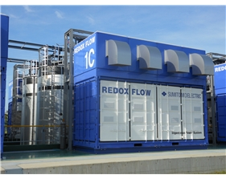
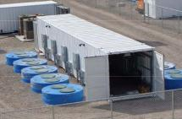
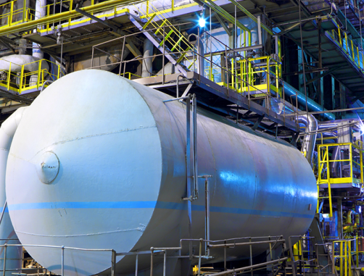
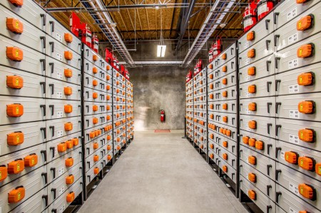
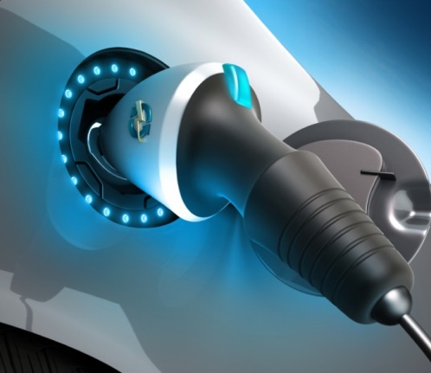
Many Types of Energy Storage Technologies
Electro-Chemical
Mechanical
Bulk Mechanical
Hydrogen
Thermal
Bulk Gravitational
Mobile
4

Slide 5
Energy Storage is Arriving in California
Energy Storage Projects in California, 2014-2023
Receiving or will receive Self-Generation Incentive Program (SGIP) or AB 2514 funds
CESA analysis of SGIP Statewide Report March 26, 2019 and AB2514 procurements. Some project lifespans may vary. Projects eligible for AB2514 and SGIP were counted only once.

Slide 6
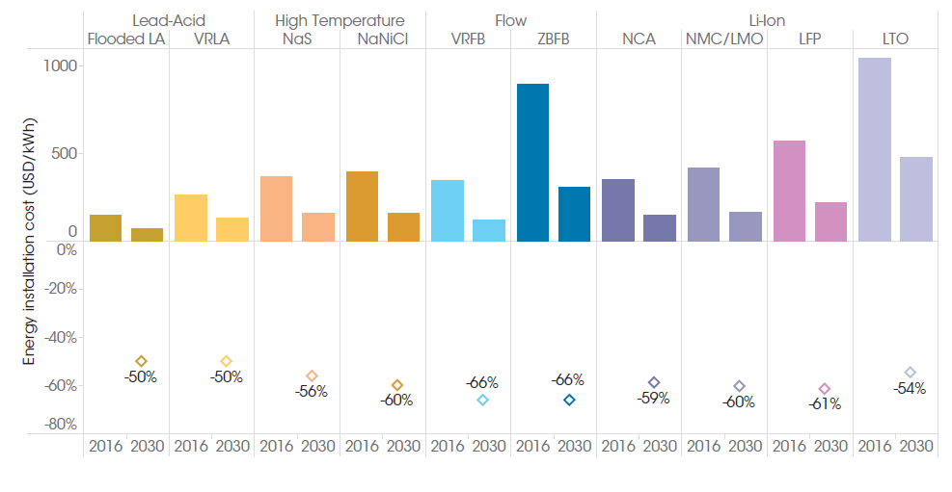
Installed Energy Costs are Falling Across Technologies
Energy Storage Installed Energy Costs Reduction Potential, 2016-2030
Source: International Renewable Energy Agency

Slide 7
Key Themes in 2019
Managing the fleet transition from gas to 100% renewables, including how to optimize our existing fleet over this ‘bridge’ period
Expanding the energy storage toolkit to look at 4-hour solutions and also longer-duration, seasonal, and other storage alternatives to meet future grid needs​
Expanding buyer class of load-serving entities (LSEs), including community choice aggregators and municipal utilities
Modeling and interconnection study process enhancements for energy storage, V2G, and hybrid storage (gas+storage, solar+storage)
Refining multiple-use applications at a wide scale, including for BTM storage​
New grid services and market products such as T&D deferral, Flex RA, RA for solar+storage

Slide 8
Contact Us
Sarah Busch
Market Development Manager
California Energy Storage Alliance
sbusch@storagealliance.org
www.storagealliance.org

