Slide 1
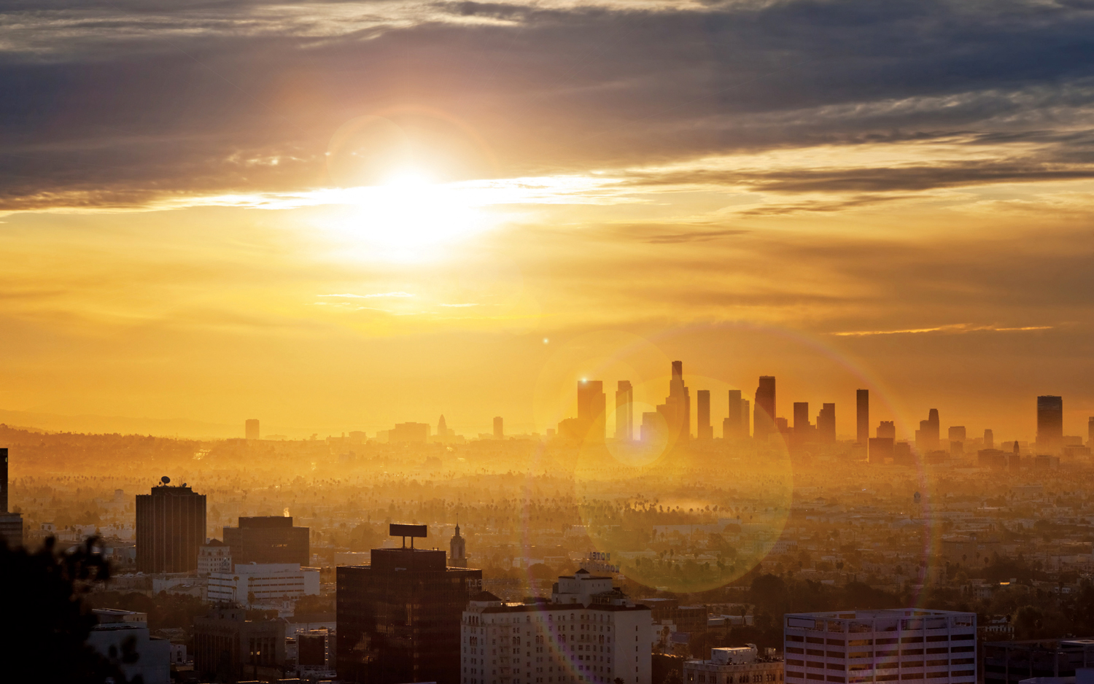



Molten Sulfur
& Why The World Needs
Thermal Energy Storage
Richard E. Wirz, Ph.D.
wirz@ucla.edu
Director, Energy Innovation Lab
UCLA, Mechanical & Aerospace Engineering
Chief Scientist / Co-Founder
Element 16 Technologies, Inc.
Energy Storage Technologies & Applications Conference
UC, Riverside
April 12, 2019

Slide 2
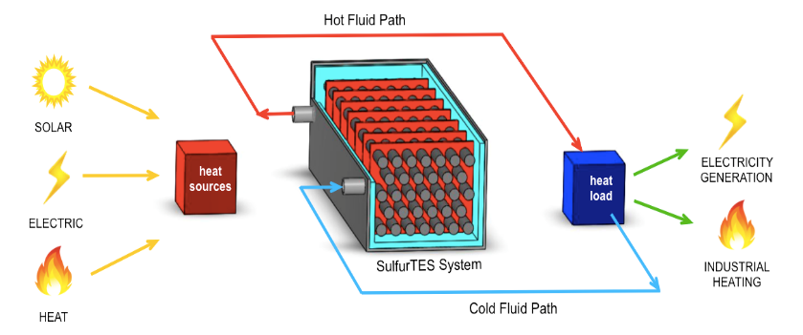
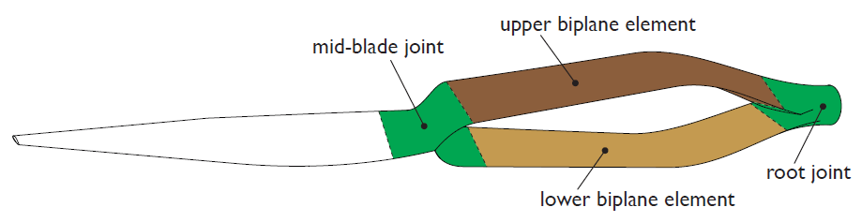
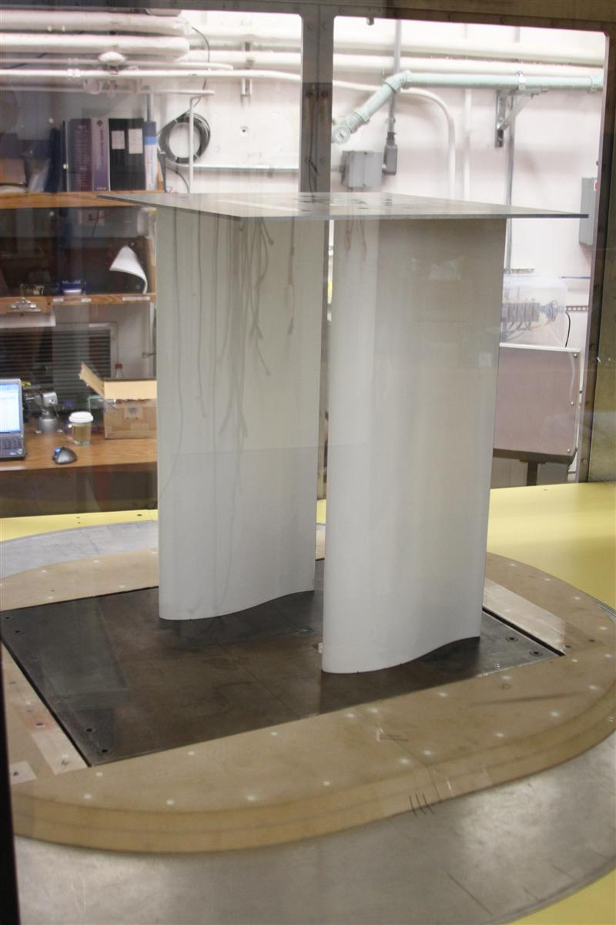
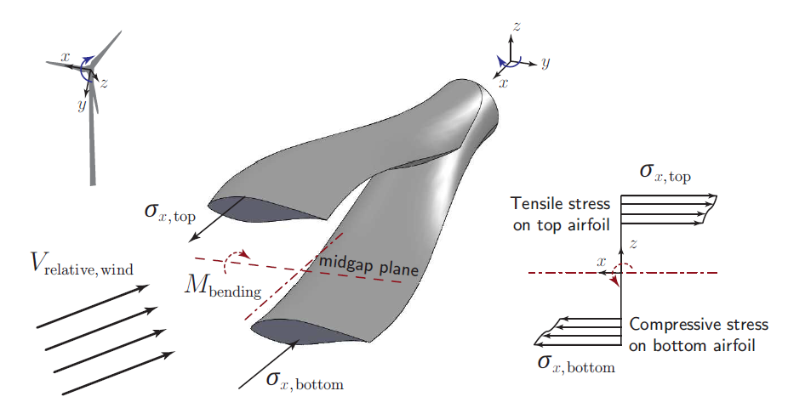
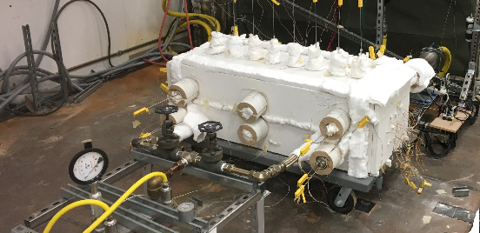
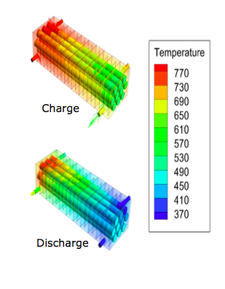
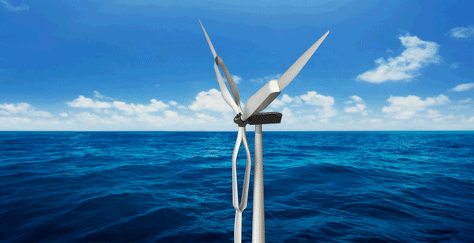
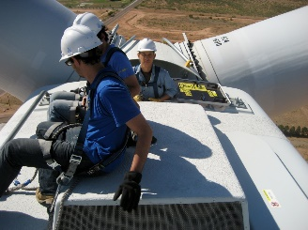
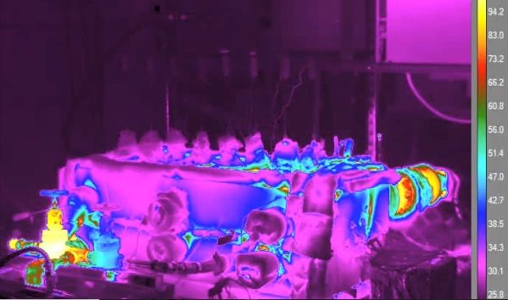
Solar/Thermal Energy
Wind Energy
  Characterization of new thermal fluids
  Aero-structural development of advanced turbine blades
The UCLA biplane blade
Aero-structural analysis
Wind tunnel testing
  Experimental Testing
  Computational Modeling
Notes:
As wind turbine blades grow longer, inboard airfoils are approaching unsustainable thickness-to-chord ratios (~45%) that limit rotor power.
A new biplane blade design uses a biplane inboard region to improve the aero-structural performance of wind turbine blades.
The biplane blade is an attractive design for large wind turbines, which are needed to provide more wind power to the grid (e.g. DOE 20% wind by 2030).

Slide 3
Sustainable LA Grand Challenge
Sustainable Los Angeles
Energy, Water, and Ecosystem
by 2050
Feasibility: Is a 100% Renewable Energy LA feasible?
Solutions: If yes, which solutions will play the largest role in reaching carbon neutrality?
Challenges: What are the major research challenges towards this goal?
Notes:
LAGC Mission: To make the Los Angeles region 100% sustainable in water and energy without harming biodiversity by the year 2050. Our piece of the puzzle is energy sustainability portion of Grand Challenge

Slide 4
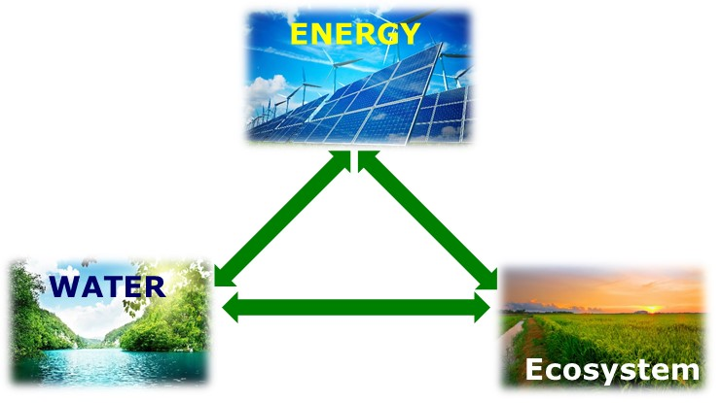

Slide 5
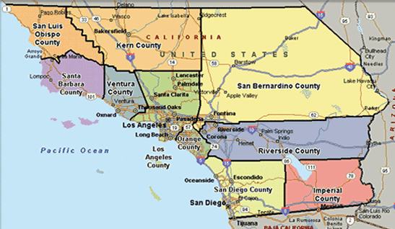
LA and the LA Region

Slide 6
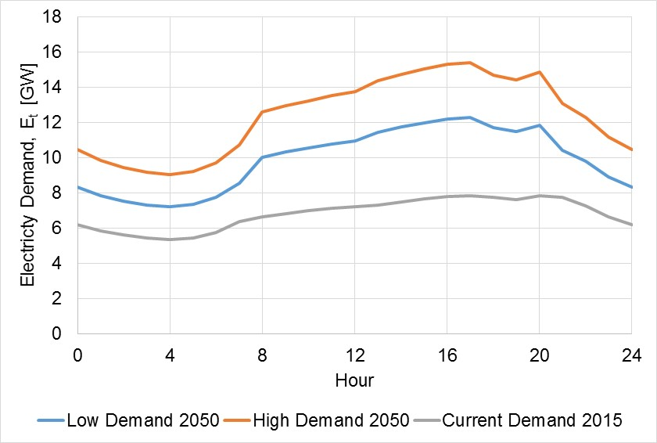
Averaged daily electricity demand (LA County)
High Demand (2050)
“Negawatts”
Low Demand
(2050)
Current Demand
Ref: California Energy Demand, Volume 1: Statewide Electricity Demand and Methods, End User Natural Gas Demand, and Energy Efficiency; California Energy Commission Final Report, Jan 2014.
Notes:
Note this is a 2050 goal. So we calculated the energy forecast in 2050 for two scenarios based on the growth rate projections from CEC which will look like this. The high demand scenario assumes relatively high economic demographic growth and low efficiency programs. The low demand case is representative of a scenario when we do a decent job with energy conservation efforts. We looked at both the scenarios here.
Now that we have looked at electricity demand, we also have to meet transportation energy needs because we want to move away from fossil fuels and also look at water. So on top of this, we have to add transportation and water. The next couple of slides will cover this.

Slide 7
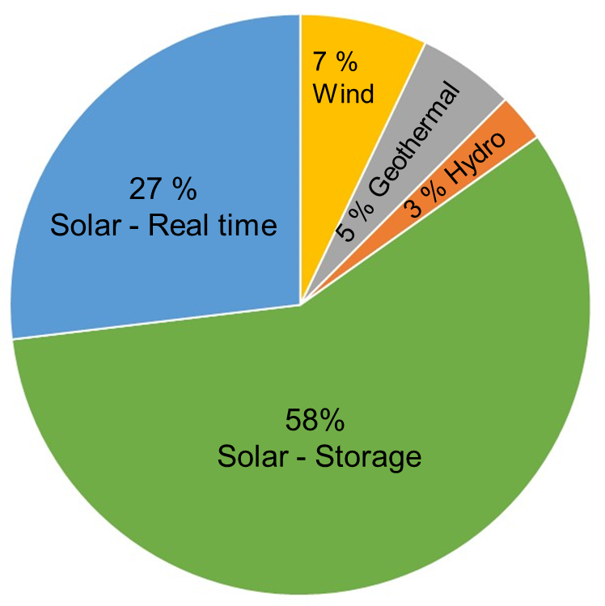
Electricity Demand and Energy Resources
Storage
Solar Storage (58%)
Storage
Solar Total (85%)
Demand Avg.
(14.4 GW)
Notes:
Wind, geothermal and hydro is only 15%. Solar is the main contributor - 85% of all the energy we need. But we need it to be dispatchable, i.e available when it is needed not just when it is most easily produced. Key is storage so that energy can be moved to morning and evening.
- If we flatten demand, we still have extremely high storage needs.

Slide 8
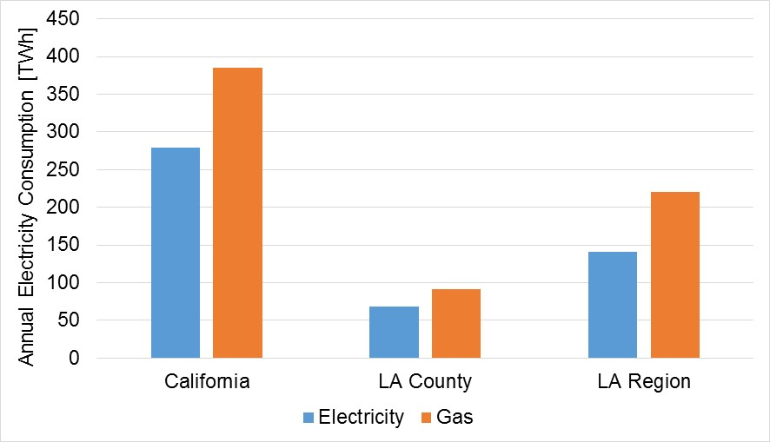
Annual Energy Used [TWh]
> 50%
~ 25%
  Data: http://www.ecdms.energy.ca.gov/
Notes:
We have to understand not only the needs of LA County but also the available renewable resources in the region. By LA region (Greater Los Angeles Metropolitan area) we mean the counties surrounding and the most important is San Bernardino, which has abundance of solar resources. In fact SEGS facility in San Bernardino was the largest solar installation in the world for a very long time.
We will first look into the needs of LA County. Just for comparison, if we look at the state of CA, the energy consumption of LA county alone is almost a quarter of CA; while LA region is in fact over 50% of the California’s total consumption. So we are a major energy sink.
(The LA region encompasses five counties, extending from Ventura County in the west to San Bernardino County and Riverside County on the east, with Los Angeles County in the center and Orange County to the southeast.)

Slide 9
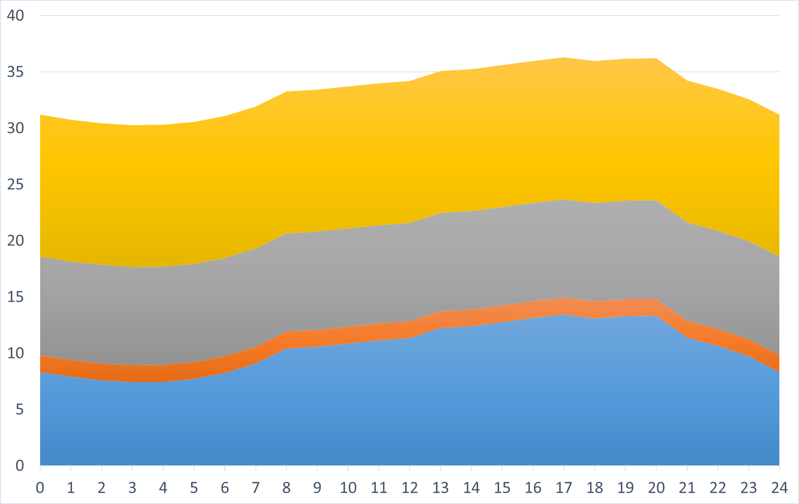
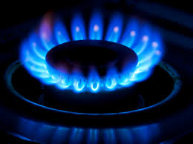
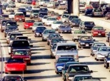

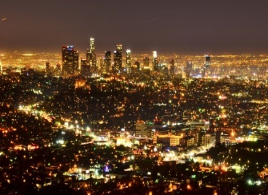
LA Co. Energy Demand Scenario (with gas!)
Natural Gas (37%)
Low energy demand scenario
(2050)
Transportation (26%)
Power Required [GW]
Water (5%)
Electricity (32%)
Time [hr]
Notes:
For this study, we assume transportation and water follow the electricity demand. But it can be reallocated to establish different supply strategies. One of the things we looked at was minimizing the grid infrastructure by making the transportation fuel in the early morning or late evening.

Slide 10
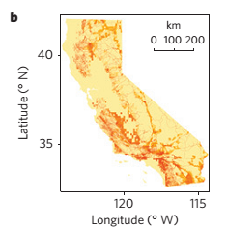

SOLAR: Demand vs. Resources
PV rooftop: only supplies ~12% of required energy!
Required Solar
  293 TWh/yr
  Maximum rooftop PV¹: 34 TWh/yr
LA Region
  Ideally suited for Concentrated Solar Power (CSP)
  2% of region compatible for CSP and 5% for PV
    avoids ecological sensitive, federally protected habitats, vegetation, roads, people, etc.²
¹LA Solar Atlas, Luskin School of Innovation
²Hernandez et al., Efficient use of land to meet sustainable energy needs, Nature, 2015.

Slide 11
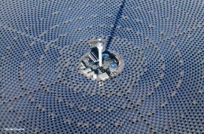
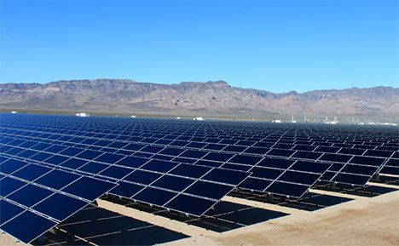
Supply Scenario for LA County in 2050
Lowest cost scenario | Low Demand | High Demand
Required Solar (TWh/y) | 293 | 327
LA County PV (TWh/y) | 34 (12%) | 34 (10%)
LA Region CSP/PV plants (TWh/y) | 73 (88%) | 96 (90%)
LA Region area required for CSP (km²) | 282 | 310
% of Compatible LA Region area required | 58 % | 64 %
% of Total LA Region area required | 1.1 % | 1.2 %
Hernandez et al., Nature, 2015.

Slide 12
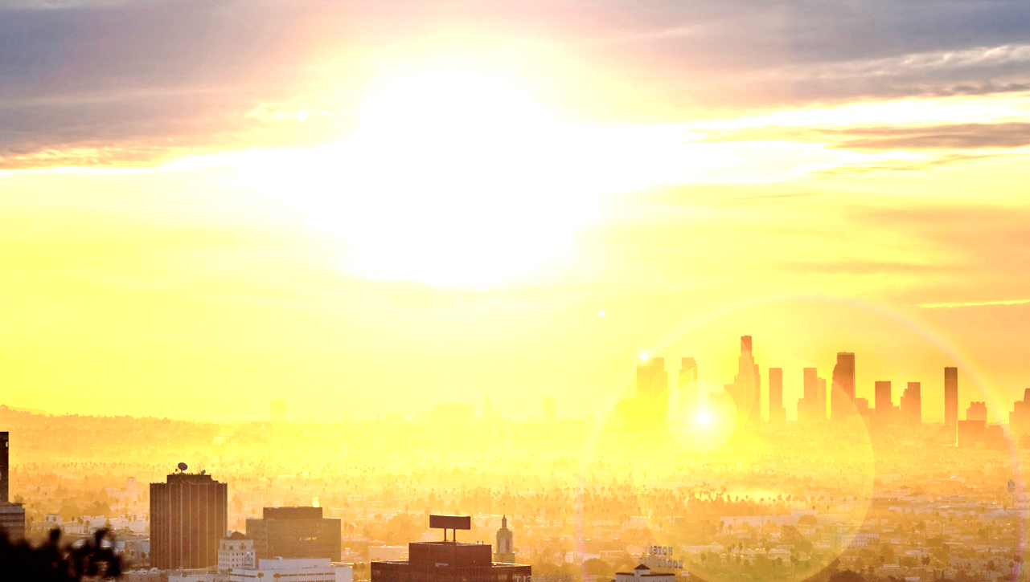
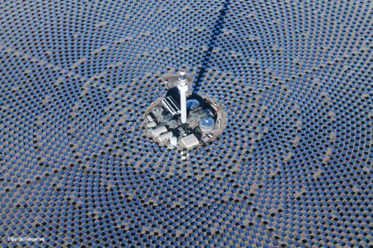
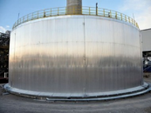
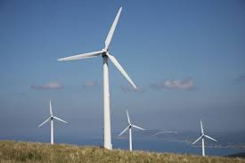

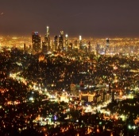
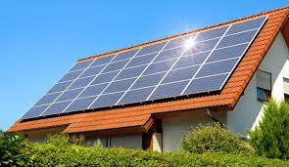
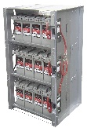
Solution
2050 Sustainable LA (Energy)
Challenge
Best-Case 2050 Energy Need:
Over 290 Terawatt-hours
Concentrated Solar Power (CSP)
Using conventional approaches…
Natural Gas (37%)
Power Required [GW]
Transportation (26%)
Water (5%)
Electricity (32%)
Time of day [hr]
Prof. Richard Wirz - Director, UCLA Energy Innovation Lab

Slide 13
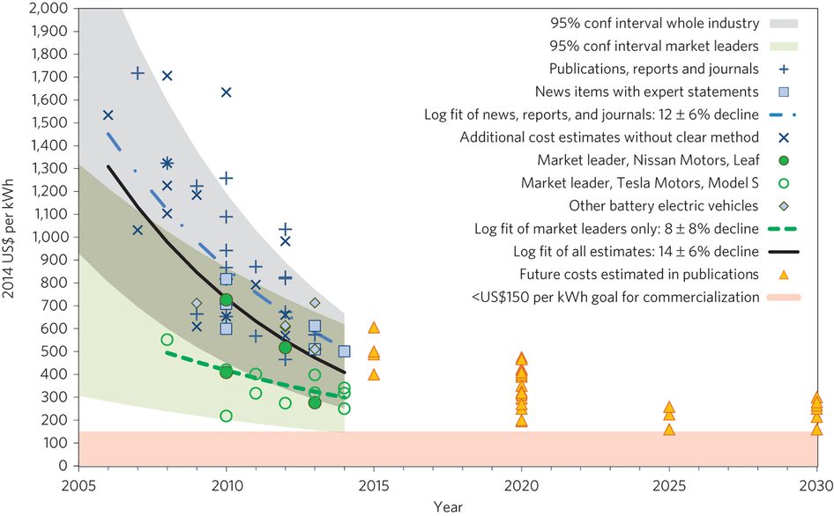




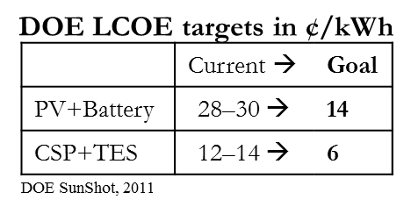
Thermal Energy Storage (TES), Why?
Battery Cost
300
275
250
225
Battery
200
175
Storage Cost [US$/kWh]
Thermal Energy Storage (TES) cost $/kWh-t
150
Thermal Energy Storage (TES) cost $/kWh-e
125
100
75
TES
50
25
10
0
2030
Figured adapted from:
Nykvist, B. and Nilsson, M. Nature Climate Change, 5, 329-332 (2015)
Year

Slide 14
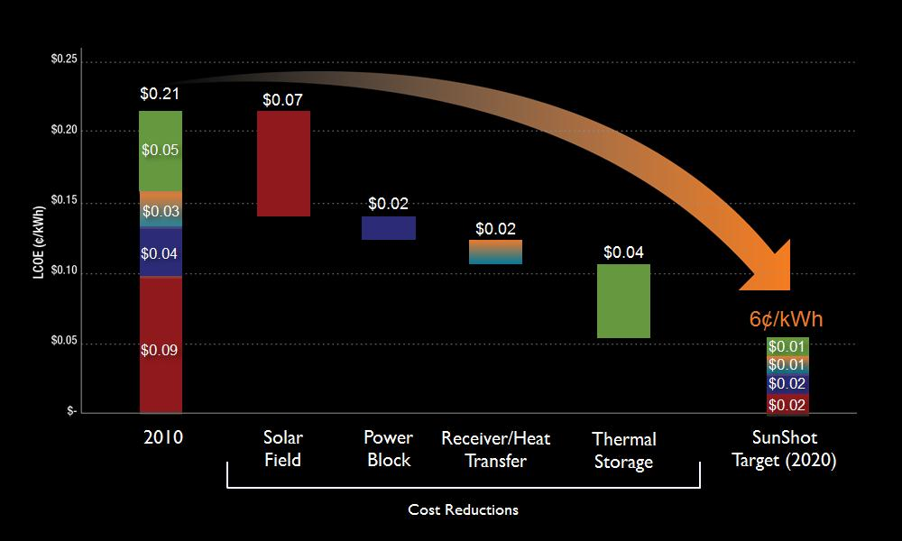
Concentrated Solar Thermal (CSP) Cost Reduction Requirements
TES
TES
Ref: DOE SunShot

Slide 15
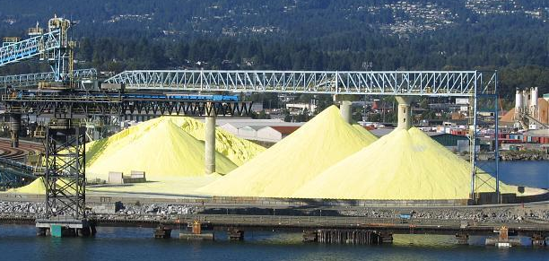
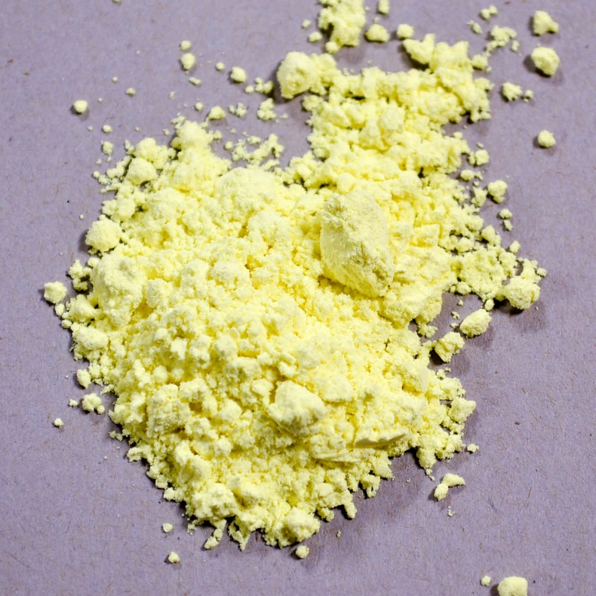
Sulfur TES Fluid
Tank
Installed System Cost
($/kWh_{t})
Tank
Fluid
(salt)
DOE Target
($15/kWh_{t})
Tank
Water/Steam
(fluid = $0)
State-of-Art
(Molten Salt)
Sulfur

Slide 16
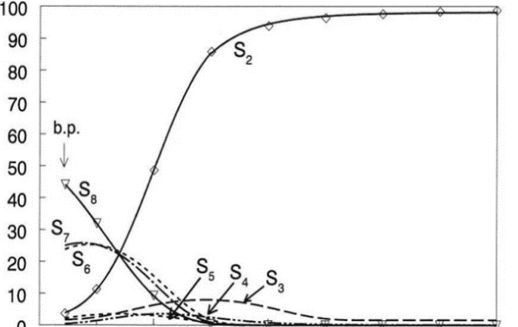
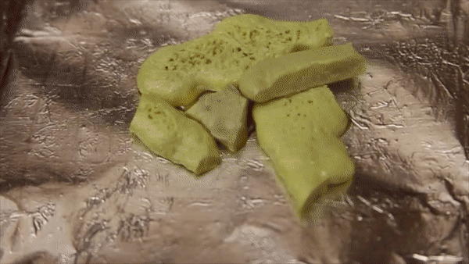
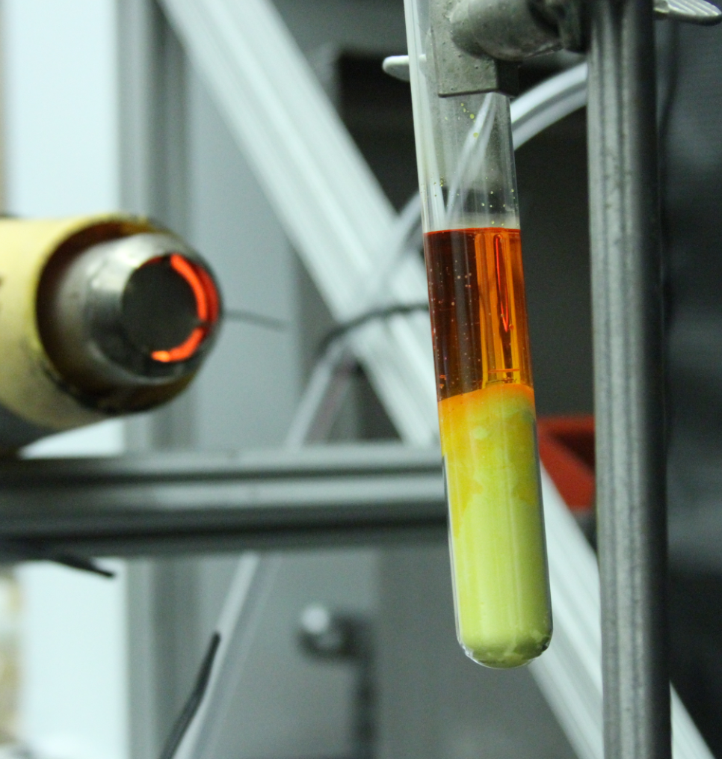
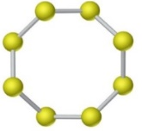

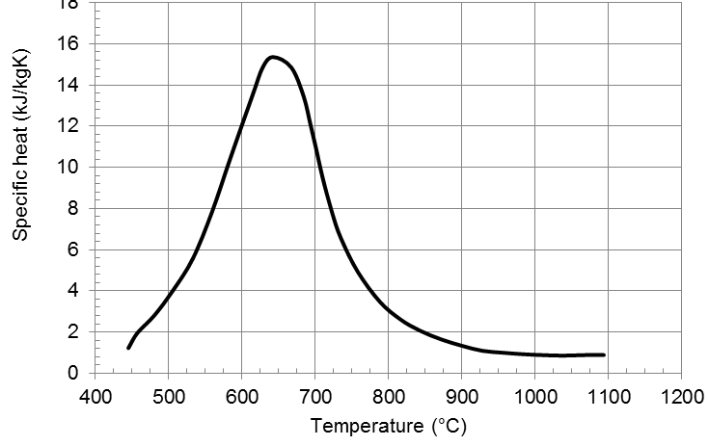
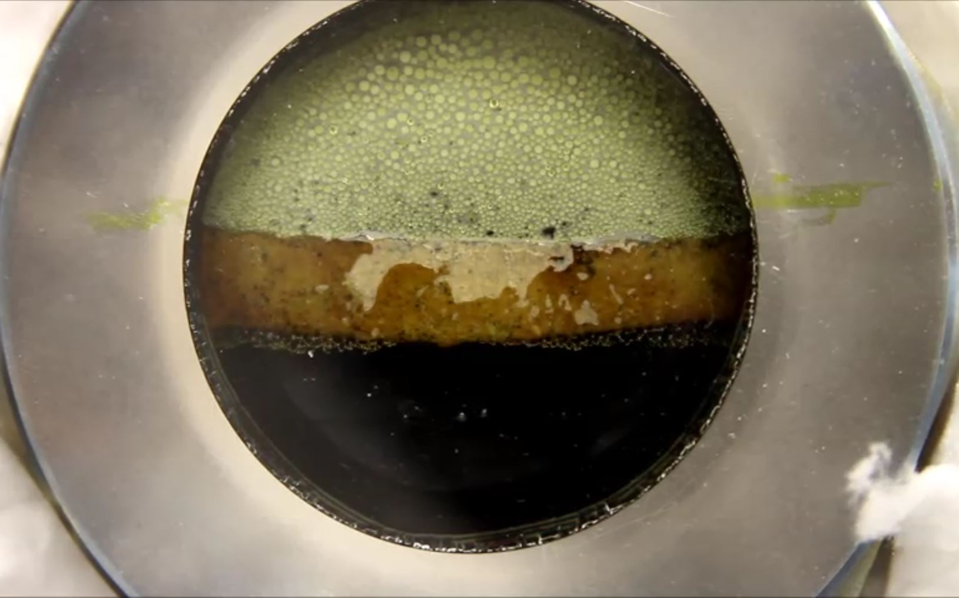

Elemental Sulfur
Clarke, et al., 2004
S₂
Composition (mole%)
S₈
$$ΔH_{r×n}$$
Latent +
Sensible + Thermochemical
Tuller, 1954

Slide 17
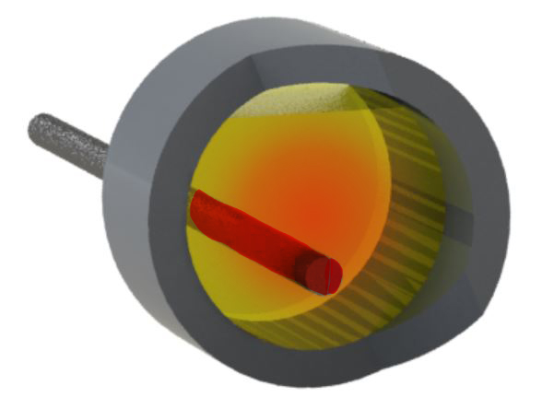
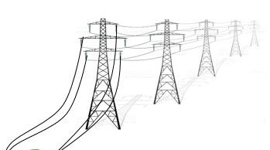



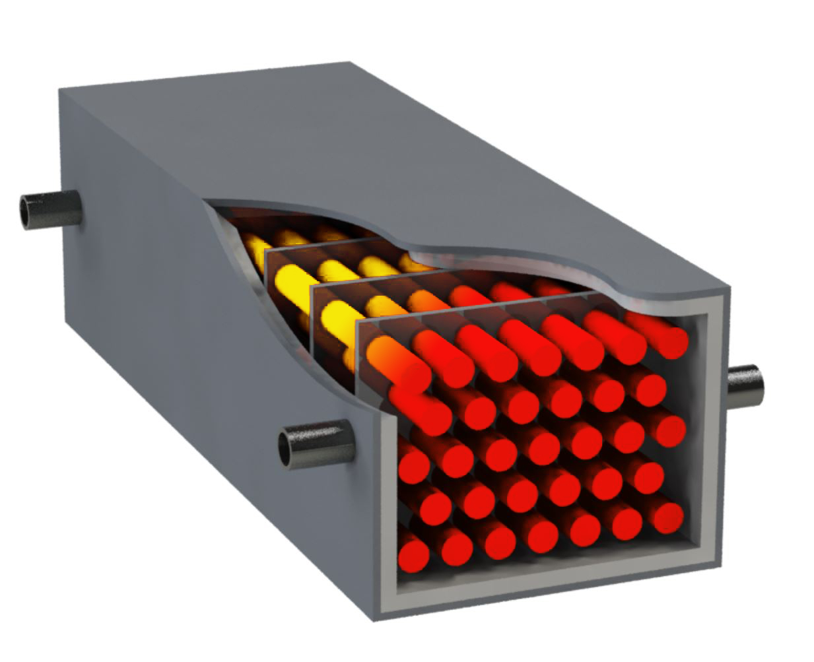
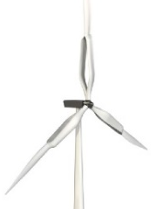











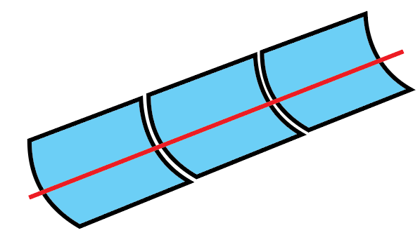
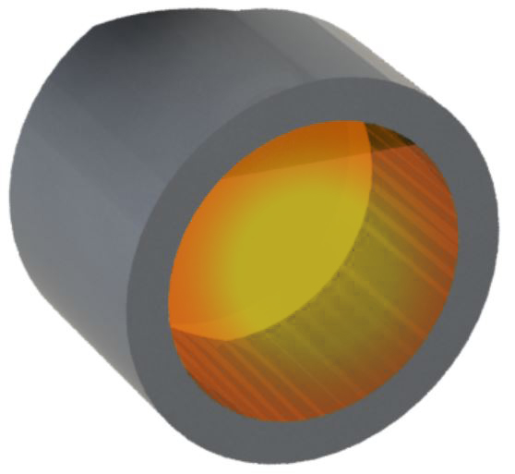
Molten Sulfur Thermal Energy Storage (TES)
Electric Heater
Electricity
Molten Sulfur
Wind
Heat output
Turbine
Generator
Electricity
Discharging loop
Industrial heating applications
PV plant
Turbine
Generator
Charging loop
Industrial heat
Heat Input
CSP plant
Molten Sulfur

Slide 18
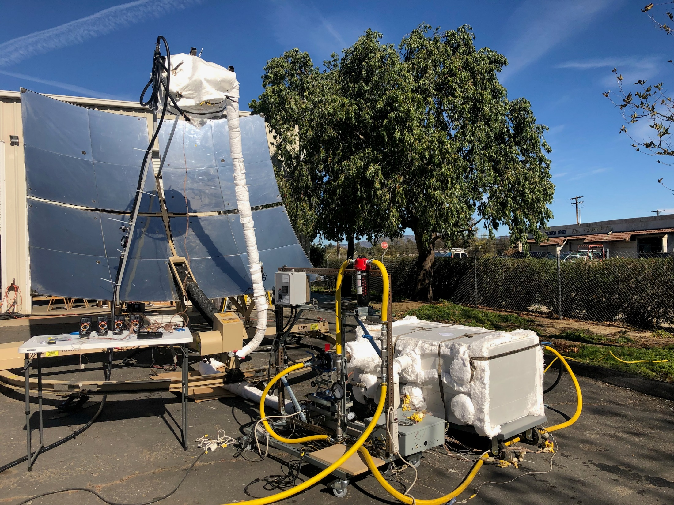
On-Sun Demonstration
CEC Award
EPC-14-003

Slide 19
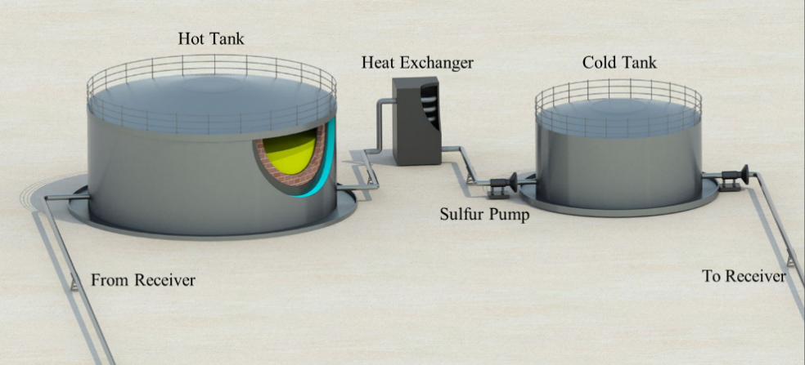
Two-Tank SulfurTES

Slide 20
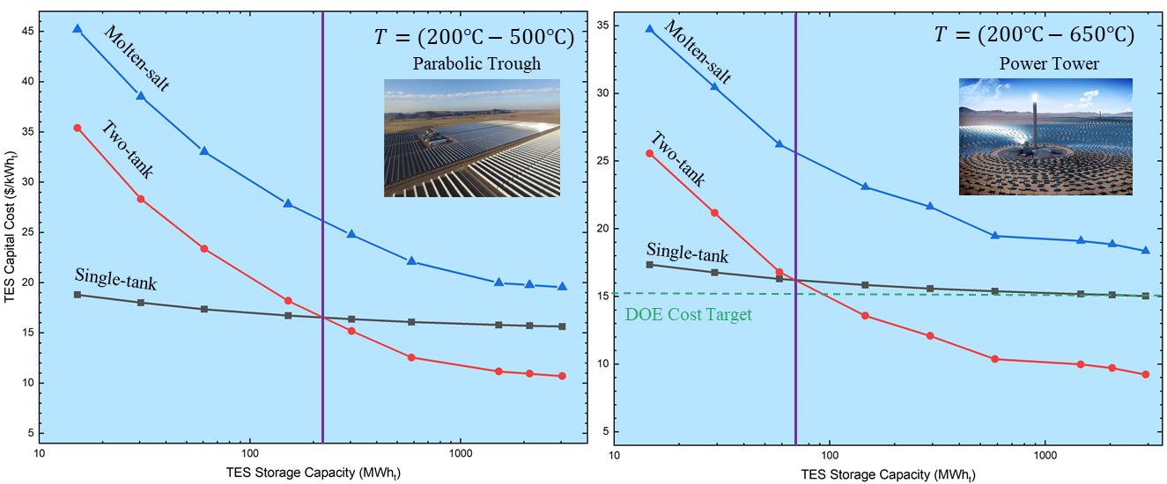
Capital cost comparison between SulfurTES and molten-salt TES
Storage capacity:
  Commercial scale (~10 MWh)
  Utility scale (~2GWh)
Operating temperatures:
  Trough (200-500 °C)
  Power tower (200-650 °C)
An order of magnitude material cost reduction by replacing molten-salt (10 $/kWh) with sulfur ($0.73/kWh), achieving DOE cost target of $15/kWh
Commercial scale: single-tank is cheaper, utility scale: two-tank is cheaper (intersect around 100 MWh)

Slide 21
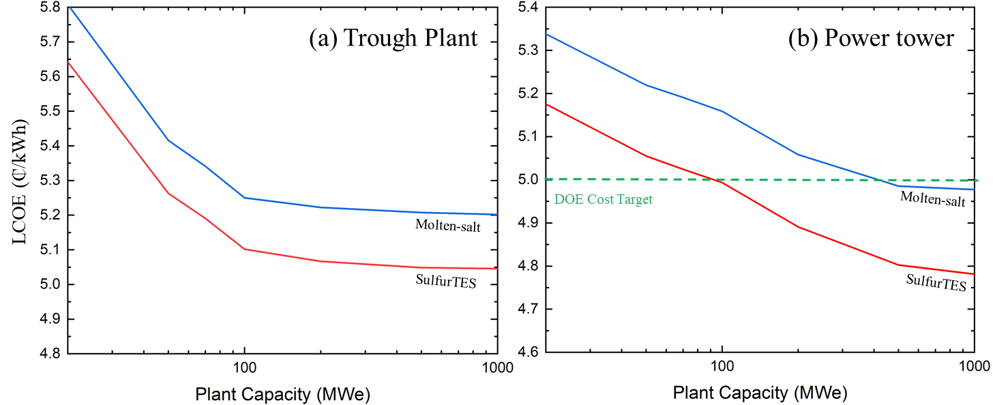

LCOE comparison between SulfurTES and molten-salt TES
LCOE = $\frac{sum of plant cost over life time}{Total energy produced over lifetime}$
Replacing Molten-salt TES with SulfurTES results in ~¢0.2/kWh reduction in LCOE
SulfurTES achieves 2030 DOE cost target of ¢5/kWh for power tower with plant capacity > 90 MWe
1 GWe power plant realizes a saving of $275M over 30-year life time with SulfurTES
Assuming 25%-50% grid penetration of CSP plant, SulfurTES yields $5.6B to $11.3B total saving to the state of California (23-46 GW installed), and a $84.6B to $169B total saving to the U.S.A (308-615 GW installed)
  Note: These are 2019 dollars at 2019 CA energy consumption levels (consumption is anticipated to grow ~20-50% by 2050)

Slide 22








www.element16.com
Industrial Sulfur Heat Storage
to improve flexible heat management and reduce wasted fuel
KEY ACCOMPLISHMENTS
Awarded $1,500,000 Heat Storage grant for Industrial Natural Gas Efficiency Installation, May 2018
Awarded $1,500,000 Heat Storage grant for small cogeneration demonstration, April 2017
Completed US National Science Foundation i-Corps program, including $25k award
TechStars Dubai Awardee
Completed fabrication of 500 kWh heat storage unit
Pending patent application on sulfur heat storage technology
Team of PhD experts in heat transfer & fluid mechanics
Less Expensive
Sulfur is 1/15th the cost of molten salt
More Compact
Sulfur Heat Storage is less than half the size of water systems
More Responsive
Liquid sulfur heat transfer is 50x faster than thermal concrete and rocks
ELEMENT 16 THERMAL BATTERY MARKETS
Heat Storage market at $3.3 Billion in 2016.
Element 16 is especially interested in the following markets:
$44 Billion Industrial Waste Heat Recovery Market
      Heat Recovery Steam Generators represent a $700M market
Concentrated Solar Power is a $3 - $12 Billion developing market
Contact:
CEO, Parker Wells
510.599.3330
parker@element16.com
www.Element16.com

Slide 23

Thank you!
Questions?
UCLA Energy Innovation Lab
www.UCLAEnergyInnovation.com
www.Element16.com
Director: Prof. Richard Wirz (wirz@ucla.edu)

