Slide 1
The Future Grid and Energy Storage
Eric Kim
CAISO Infrastructure & Regulatory Policy

Slide 2
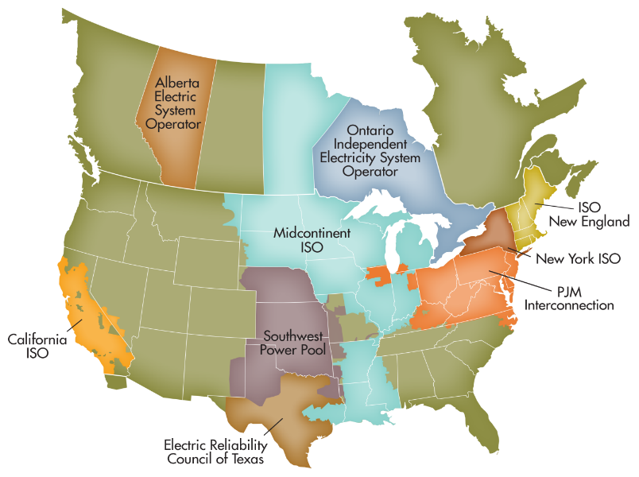
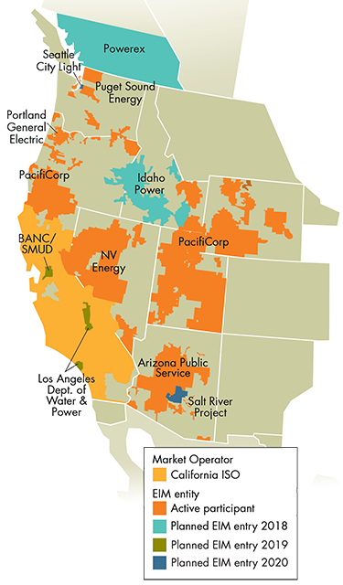
The California Independent System Operator (CAISO)
Nonprofit public benefit corporation
created by CA statute
regulated by the Federal Energy Regulatory Commission (FERC)
not a government agency
One of 38 balancing authorities in the western interconnection
50,270 MW record peak demand (7/24/2006)
Serving 80% of CA & bit of NV
31,000 daily market transactions
$9.3 billion market
30 million people served

Slide 3
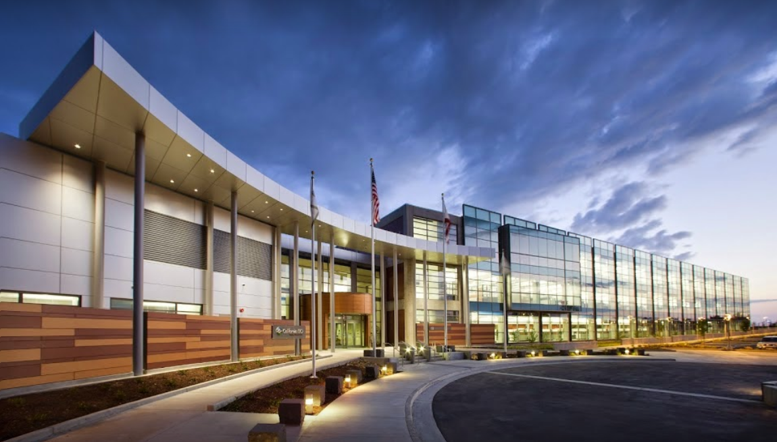
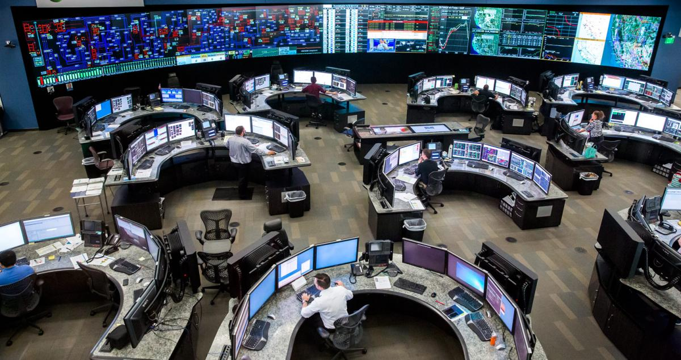
Key functions of the CAISO
Uses advanced technology to balance supply and demand every 4 seconds
Operate markets for wholesale electricity and reserves
Day Ahead
Fifteen Minute
Five Minute
Oversees future transmission planning and new generator interconnections
Folsom, California

Slide 4
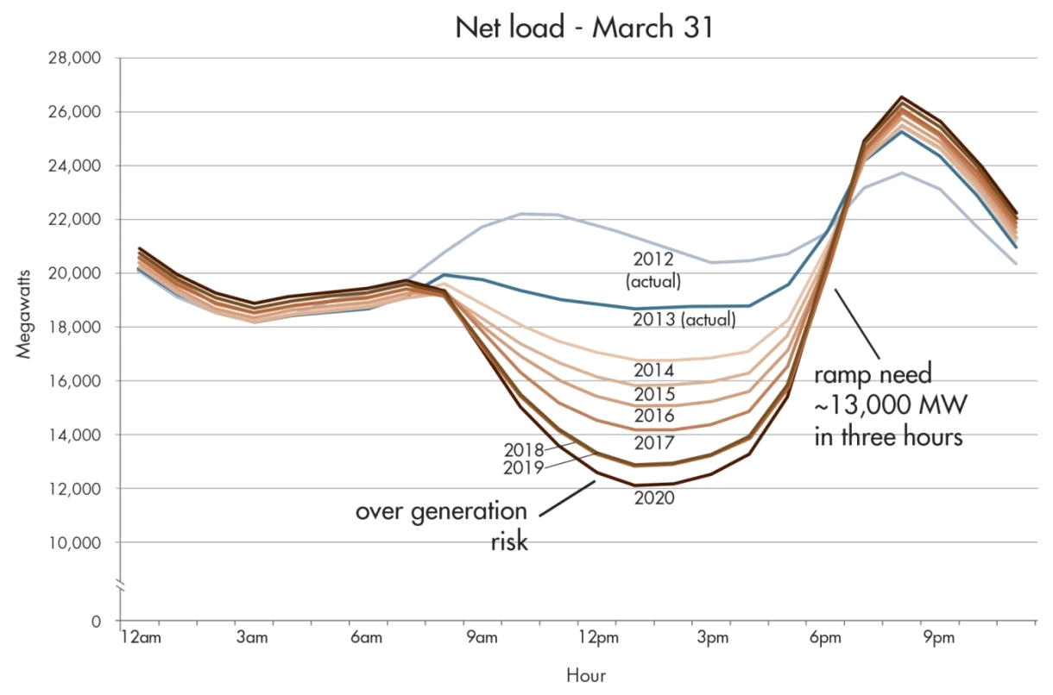
Reliably operating the system has grown more challenging
Typical Spring Day
Steeper
Upward
Ramps
Actual 3-hour ramp of 14,777 MW on March 4, 2018
Steeper
Downward
Ramps
Net load of 7,149 MW on Feb 8, 2018
Deeper
Belly
We must learn how to favorably shift and shape net load to maximize the use of clean, green energy
“Less Steep, Less Deep, and Lower Peak”

Slide 5
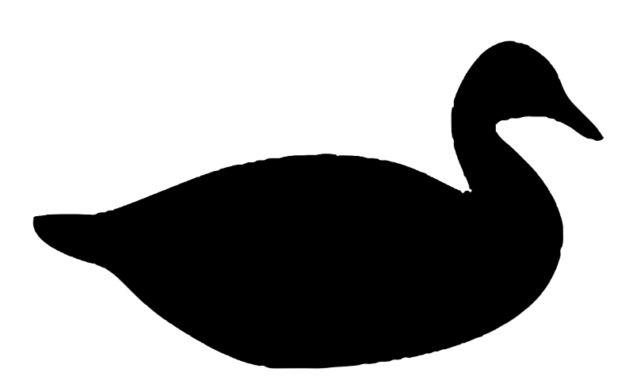
How are we going to ensure our energy future is resilient, sustainable and efficient?
We must make the duck fly!

Slide 6
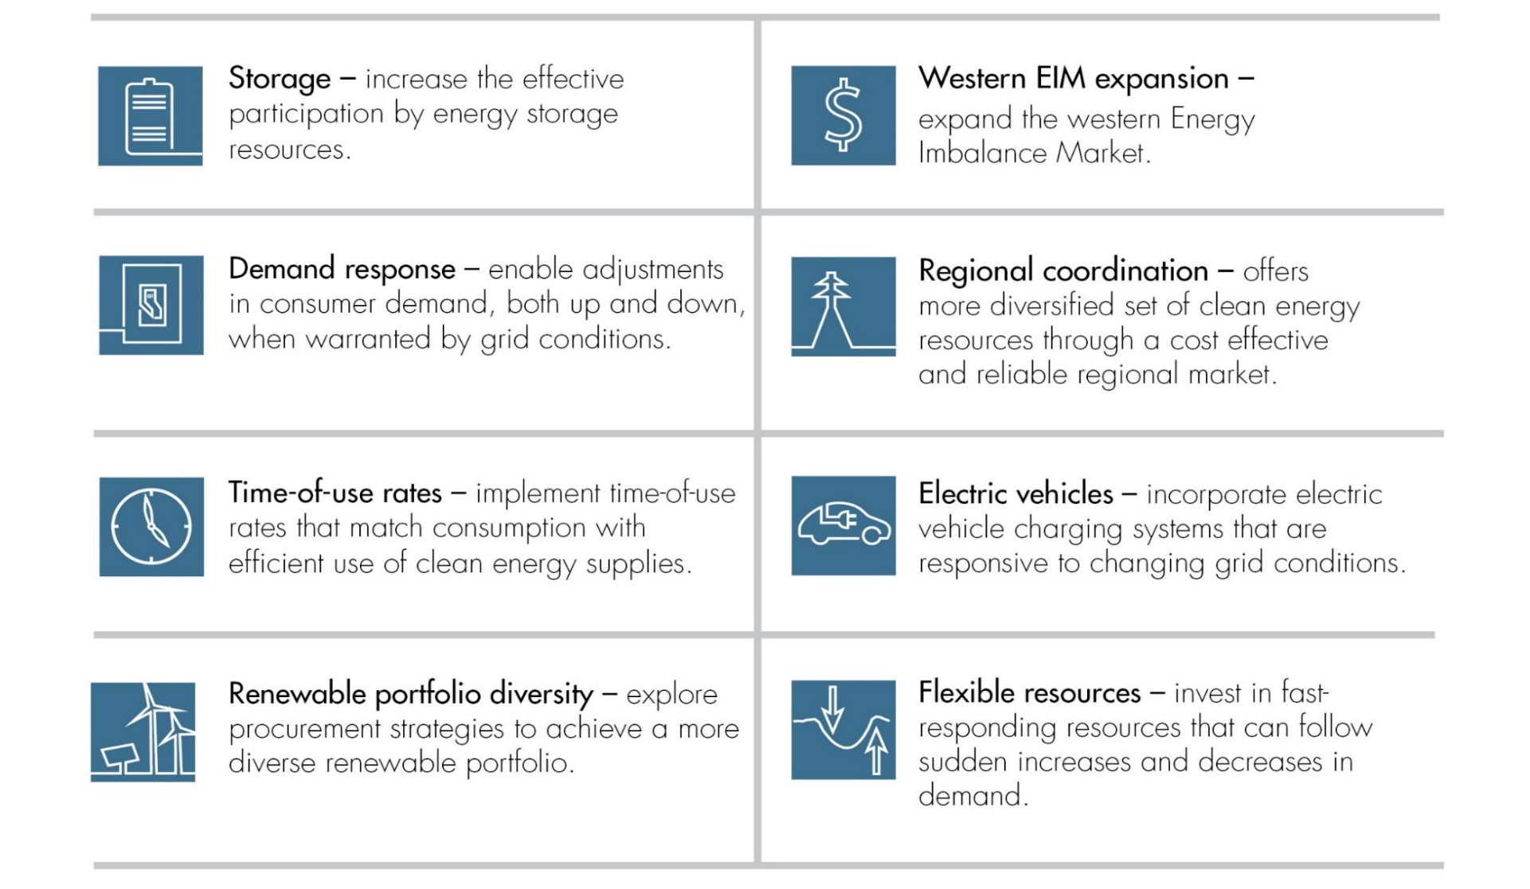
Planning for the Modern Grid: A suite of solutions include energy storage applications

Slide 7
CAISO has several models available for Energy Storage participation in its markets
Proxy Demand Resource, 2010 (PDR) – Distribution
Supplier can aggregate multiple end-use customers to create a virtual supply resource
May involve other DER types behind customer meter, but will not be settled in market for net energy injection to the system (load offset only)
Non Generator Resource, 2012 (NGR) – Transmission & Distribution
Designed for a resource that can vary between consuming & producing energy (e.g., storage, V2G)
The non-generator resource (NGR) participation model recognizes a seamless operation between generation and load
DER Provider, 2016 (DERP) - Distribution
Create a pathway for DERs to be aggregated and meet .5 MW minimum participation requirement
Allows aggregations from resources in front of and behind the end-use customer meter

Slide 8
Industry-wide collaboration is required to achieve the future of a cost-effective and low carbon grid
Wholesale | Retail | Legal/Regulatory
Technology agnostic market participation models that allow large, small, and aggregate resources to participate | Grid informed time-variant and dynamic rates (TOU, RTP) | Electrification goals and mandates designed to create a sustainable and efficient grid
Market structures that reward flexibility and minimize uncertainty | Critical peak and critical consumption pricing periods | Grid harmonized building codes and appliance standards
Regional markets that leverage diversity and generate operational efficiencies | Load management programs that reward favorably shifting and shaping energy use | Retail markets, structures that create resiliency, grid-informed price signals, and low-friction energy exchange

Slide 9
We must consider the future grid architecture. Consider an “integrated decentralized” system with a layered hierarchy of optimizing sub-systems.
Regional Interconnection
Each layer only sees its interchange with next layer above & below, not the details inside other layers
ISO optimizes regional bulk system only up to the T-D interfaces: DSO to ISO
Layered control structure reduces complexity, allows scalability, and increases resiliency & security
Resolve variability and volatility at the grid edge
Deep and centralized situational awareness and control not required
Optimization
BAA
CAISO Balancing Authority Area
BAA
DSO
DSO
DSO = Local Distribution Area or Community Microgrid
Micro-grid
Micro-grid
Smart building
Smart building
Smart building
Top down, centralized control of an increasingly decentralized system is likely not viable or desirable

Slide 10
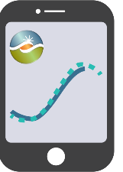
Stay connected
THANK YOU
Download ISO Today
mobile app
Sign up for the Daily Briefing at www.caiso.com
@California_ISO

