Slide 1


Integrating Renewable Resources into the Grid as we Transition to 100% Renewable Energy
Insert your organizaion’s
logo here
Angelina Galiteva
Vice Chair of California Independent system Operator & Founder and Board President, Renewables 100 Policy Institute

Slide 2


Founded in 2007
Mission:
To study and accelerate the global transition to
100% renewable energy in all sectors – electricity transportation, heating cooling, water treatment and fuels .

Slide 3
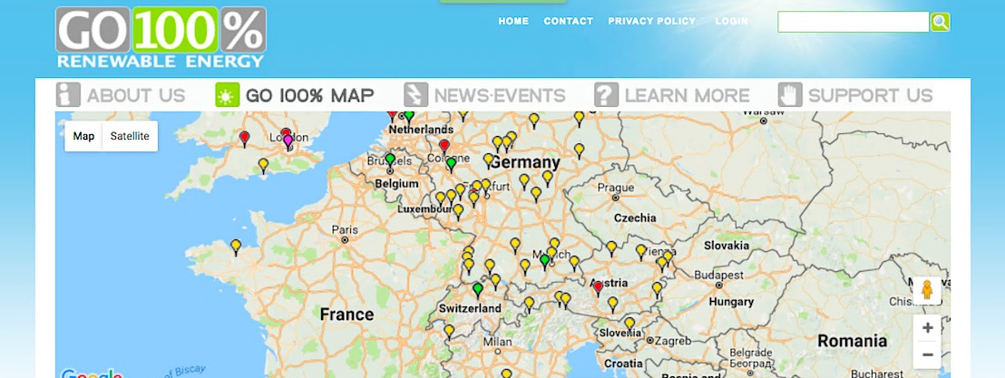
Highlights
Go 100% Renewable Energy Project
Shows how and where 100% Renewable Energy is happening now.
It’s not a fantasy for someday, but a reality for today
Mapped so far: Over 356.7 million people (and counting…)
who have shifted or are committed to shifting within the next few
decades to 100% renewable energy in at least one sector.
Notes:
There are about 40 more countries to map since the Climate Vulnerable Forum pledge at COP 22, and about 5 more cities to map just from the last few weeks.

Slide 4
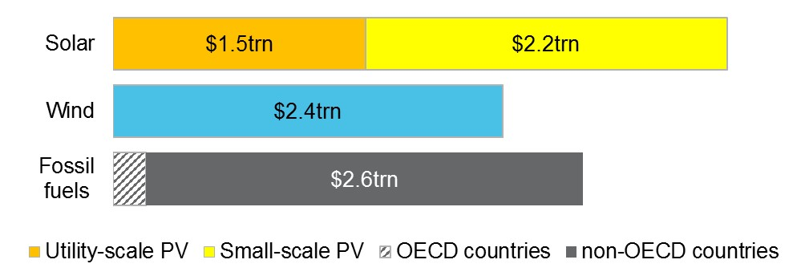
Total investments per technology, 2015-40 (US$)
RENEWABLES TAKE
65% OF THE $12.2 TRILLION POWER INVESTMENT TO 2040
Source: Bloomberg New Energy Finance

Slide 5
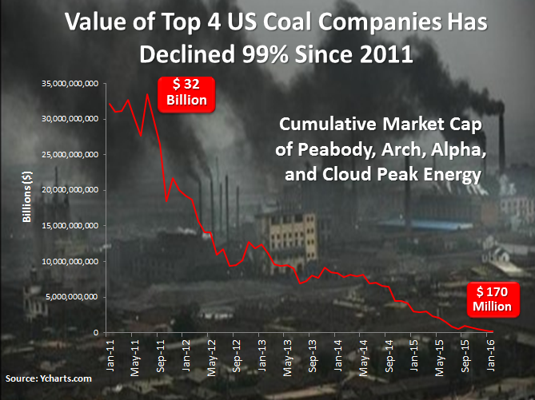

Slide 6
NEX clean energy index 2013 – 2015 ytd
“Divestment by value destruction”
Note: Values as of 08 September 2015; Stowe and S&P 500 rebased to 100 on 01 Jan 2013
Source: Bloomberg New Energy Finance

Slide 7
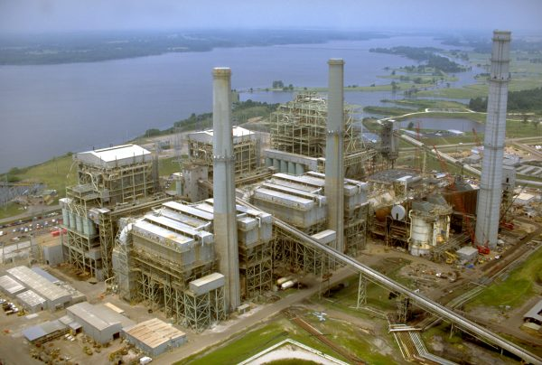
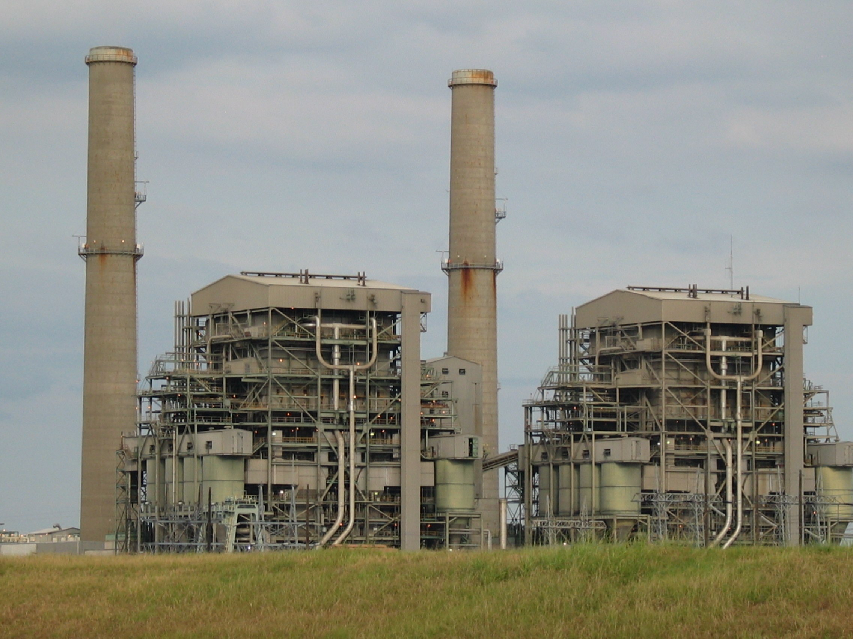
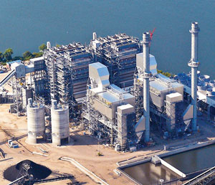
Vistra/Luminant’s recent Texas retirement announcements
Monticello, East Texas
1,880 MW
Big Brown, Freestone County
1,150 MW
Sandow, Milam County
1,137 MW
Images: Luminant; various

Slide 8
US power sector fuel mix
Change in generation 2007-16
TWh/yr
Source: EIA

Slide 9

Solar and wind attract 60% of new investment in power generating capacity
Investment, by technology, 2017-2040
Investment, by technology, 2017-2040
Source: Bloomberg New Energy Finance, NEO 2017
Source: Bloomberg New Energy Finance
Source: Bloomberg New Energy Finance
Source: Bloomberg New Energy Finance
Notes:
Solar & wind – 60% of investment
32% of total to wind
27% to total solar

Slide 10
Why renewable jobs matter

Slide 11
High Levels of Renewable Penetration
13 February 2017
SPP
52% wind
25 December 2016
Scotland
153% wind
9 July 2015
Denmark 140% wind
9 April 2017
UK 56% wind & solar
May 2016
Germany
67% wind & solar
23 March 2017
CAISO
46% wind & solar
26 December 2014
South Australia
61% wind & solar
November 2015
Spain
70% wind
November 2017
ERCOT
45% wind
Source: Bloomberg New Energy Finance, various
Notes:
Make pretty

Slide 12
California’s leaders are aggressively pursuing a low carbon future.
Aggressive renewable energy goals
33% by 2020
60% by 2030
100% by 2045
Deep greenhouse gas (GHG) reduction goals
2020 Target
Reduce GHG emissions to 1990 levels
2030 Target
40% below 1990 levels
2050 Target
80% below 1990 levels
Robust electric vehicles goal: 5.0 million by 2030, $2.5B investment in new charging stations
10,000 MW of distributed generation by 2021; 1.3 GW of battery storage by 2024
Decarbonization is creating opportunities to develop a high renewables and high DER energy service industry.
Notes:
California is ahead of schedule for meeting the RPS requirements: 25% in 2014.

Slide 13
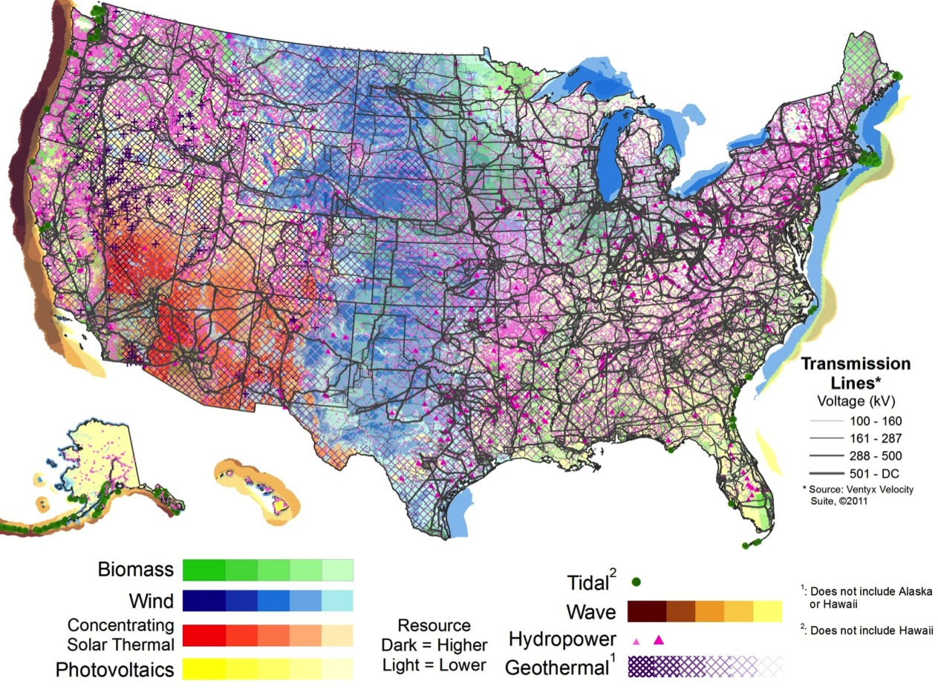
U.S. Renewable Resources
Achieving 100% Renewables include:
- Grid modernization
- Storage options
- Transmission
- Behaviors/education
- Resources
- Cooperation
….
Resource | Solar PV/CSP) | Wind | Geothermal | Water Power | Biopower
Theoretical Potential | 155,000 GW (PV) 38,000GW (CSP) | 11,000 GW (onshore) 4,200 GW (offshore to 50 nm) | 38 GW (conventional) 4,000 GW (EGS) | 68 GW | 62 GW
Notes:
Sustainable energy production from carbon neutral sources is slow. We need to step up deployment to deal with environmental challenges.
The total U.S. electricity generation is 1168GW (2014).
Let’s consider the total electricity generation in relation to renewable energy resources, the theoretical potential for renewable energy resources, and the actual renewable generation by source.
This renewable energy resource map identifies renewable resource geographic concentration. The overlapping grid shows transmission interplay with the renewable energy. This data demonstrates the opportunity to increase the use of clean energy technologies to meet the current electricity demand, and the need to address energy systems integration.
Generation stats source EIA, 2015

Slide 14
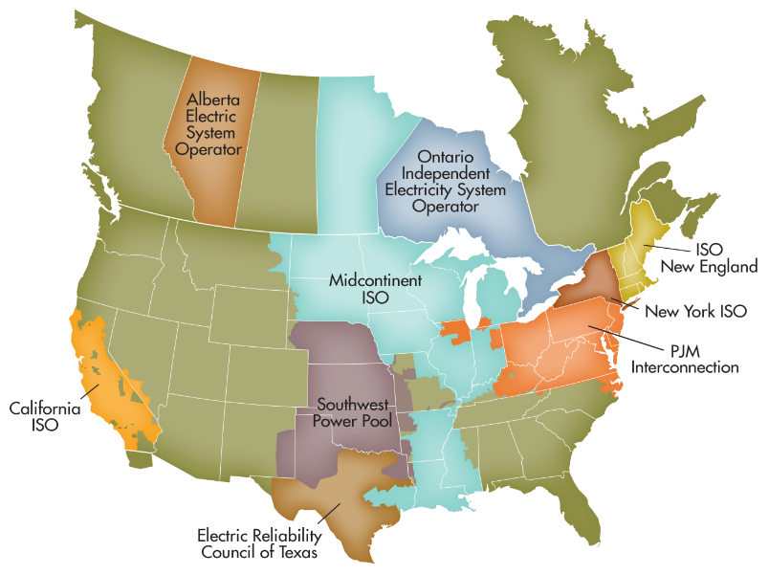
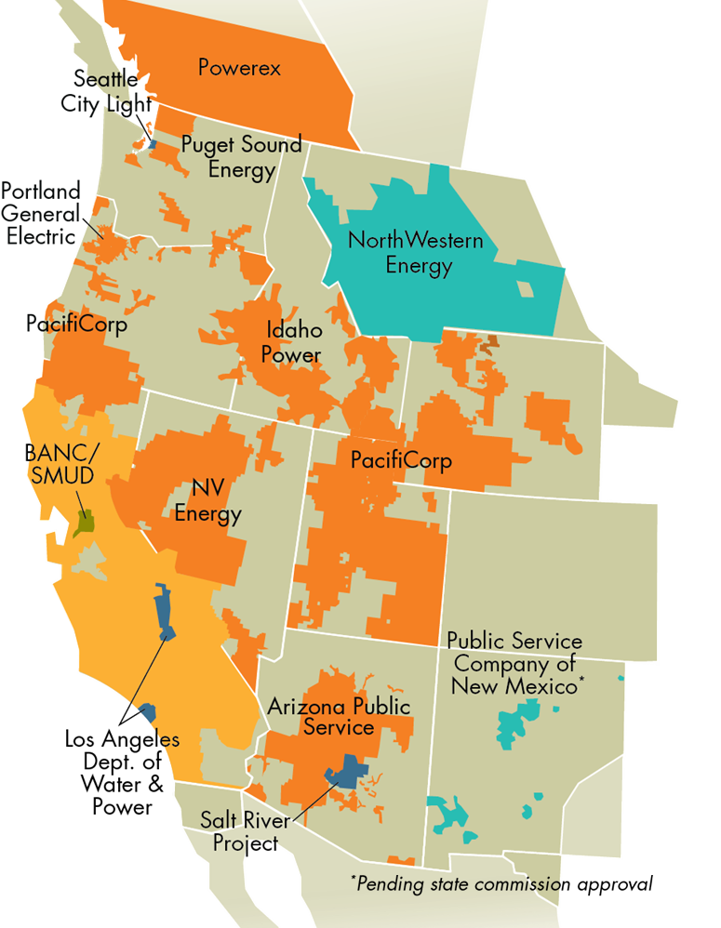
The California Independent System Operator (CAISO)
Nonprofit public benefit corporation
  created by CA statute
  regulated by the Federal Energy Regulatory Commission (FERC)
  not a government agency
One of 38 balancing authorities in the western interconnection
50,270 MW record peak demand
(7/24/2006)
Serving 80% of CA & bit of NV
31,000 daily market transactions
$9.3 billion market
30 million people served
Notes:
All-time season peak = 50,270 MW set on 7/24/2006
Total RPS resources = 21,951.64 MW 44%
Max Demand Served by All Renewables = 73.9% set on 5/26/2018

Slide 15
Energy storage technologies are essential to achieve California’s clean energy goals
Energy Storage Benefits
Reduce emissions of greenhouse gases
  Energy storage can displace the use of fossil fuels to generate electricity and reduce gasoline usage in vehicles
Reduce demand for peak electrical generation:
  Energy storage can be used in place of natural gas peaking plants in peak electricity demand hours
Defer or substitute for an investment in generation, transmission,
or distribution
  Energy storage can complement fluctuations in energy from solar
  and wind resources
Improve the reliable operation of the transmission or distribution grid
  Energy storage technologies can provide essential reliability services including frequency regulation, voltage support, ramping needs and
  time-of-use bill management

Slide 16
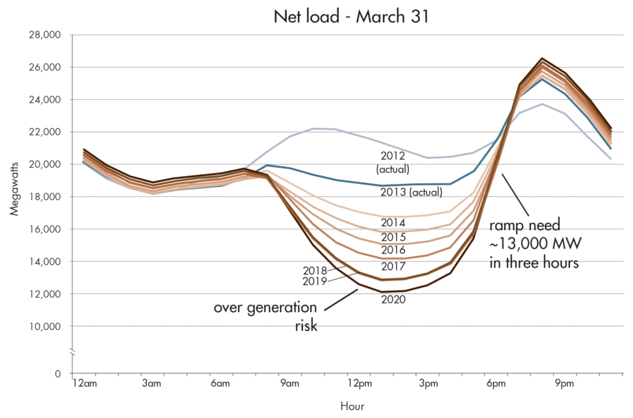
The duck turns 10 years old: Actual results are approximately four years ahead of original estimates
Typical Spring Day
Actual 3-hour ramp of 14,777 MW
on 3/4/18
Net load of 7,149 MW on 2/18/18

Slide 17
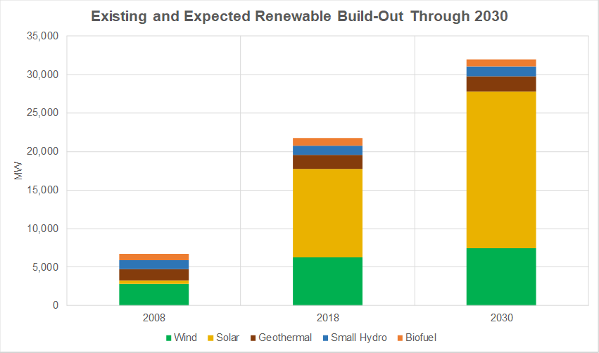
Growth of renewables to achieve 60% by 2030 is expected to be largely solar

Slide 18
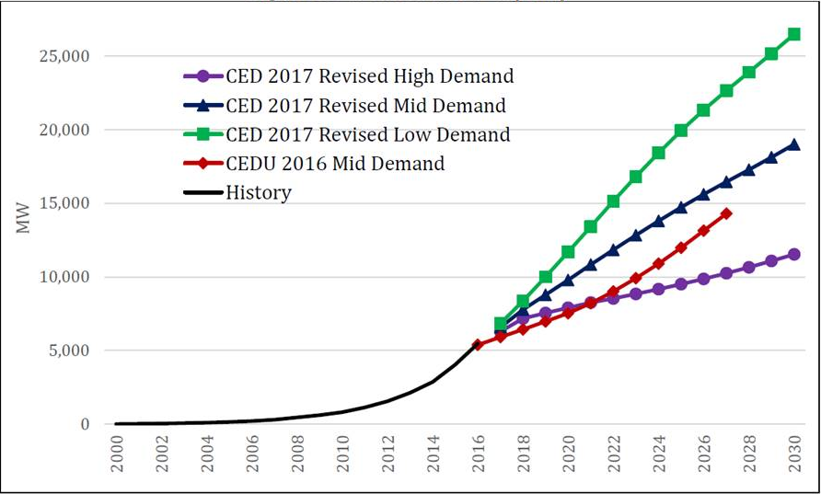
Behind the meter solar is expected to grow by approximately 15,000 MW by 2030

Slide 19
Hybrid energy storage projects in the interconnection queue are dominated by solar + battery configuration

Slide 20
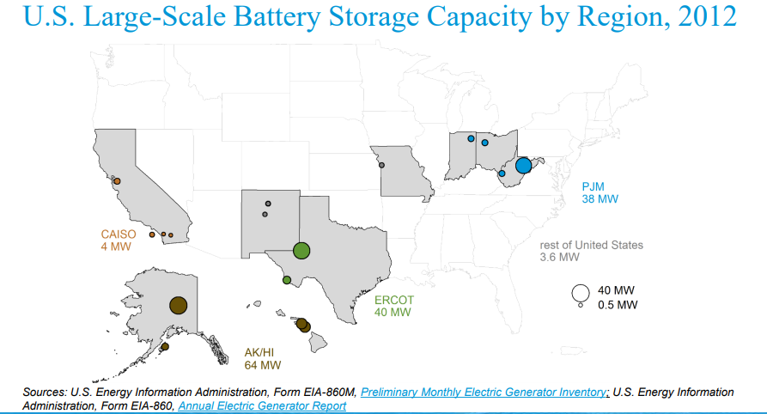
CAISO has seen an explosive growth in large-scale battery storage capacity in the last five years

Slide 21
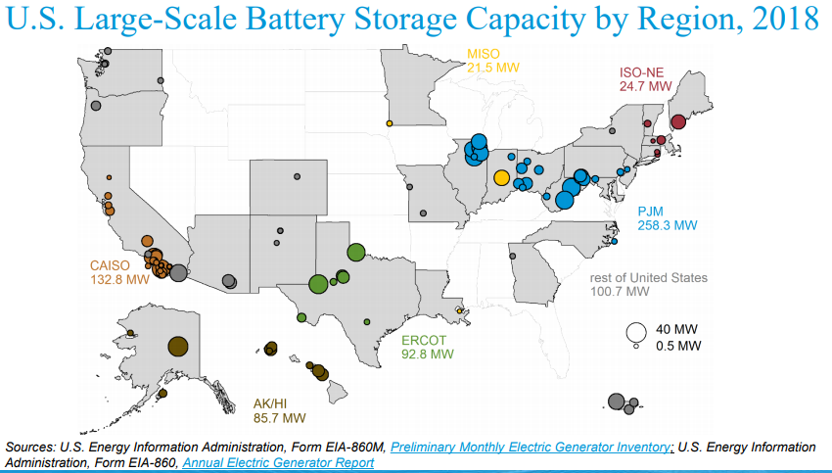
CAISO has seen an explosive growth in large-scale battery storage capacity in the last five years

Slide 22
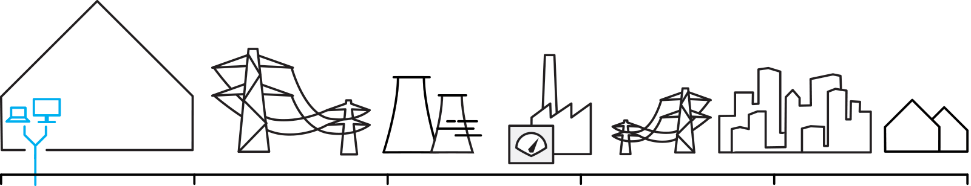

Batteries in wholesale markets deliver value in different timescales
Market
Delivery Window
Resource Adequacy Capacity markets | Energy (Day-Ahead) | Energy (Real-Time) | Ancillary Services
Years | Hours | Minutes | Seconds
Peak load firming
Daily dispatch
Intra-hourly adjustments
Frequency control
Passive market | Active markets
Additional use-cases will add complexity and value
Source: Bloomberg NEF (CAISO Symposium-2018)
Notes:
YS

Slide 24
California has a variety of advanced energy storage technologies operating today
Thermal Energy Storage with Ice
Vehicle-to-grid demonstration
Molten Sulfur Energy Storage Used for Back-up Power
Revolutionizing Grid-connected Energy storage
Integrated Solar Photovoltaic Energy storage
New Life for Electric Vehicle Batteries
Rechargeable Electrolytes
Capturing Wind
Lithium-Ion Battery Supports Renewable Energy Integration
Hybrid Technology
Hydrogen – Electrolytic (Future under SB 1369)

Slide 25
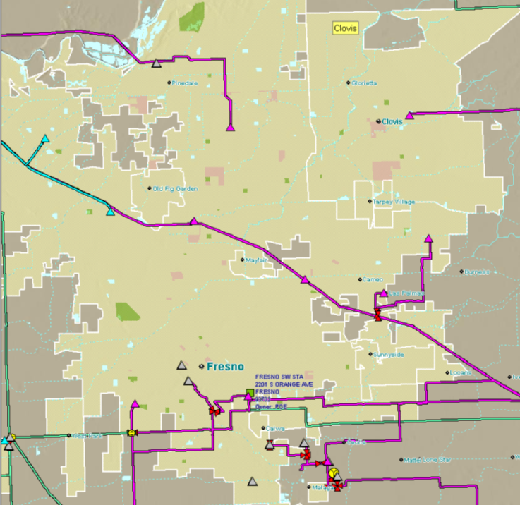
Central Fresno Transmission System
Transmission
Transmit bulk power from generation facilities to distribution substations
Largely network design

Slide 26
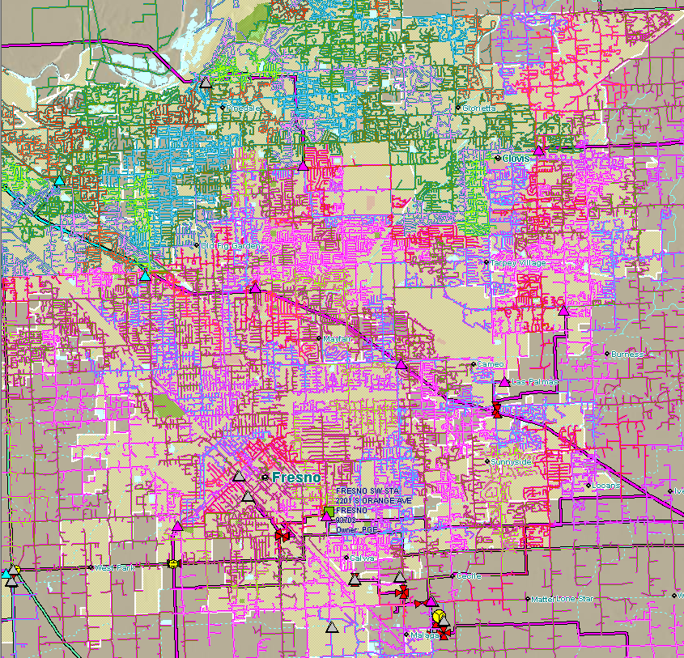
Central Fresno Transmission and
Distribution Systems
Distribution
Distributes electric power to end users (customers)
Radial design
Requires various levels of granular review

Slide 27
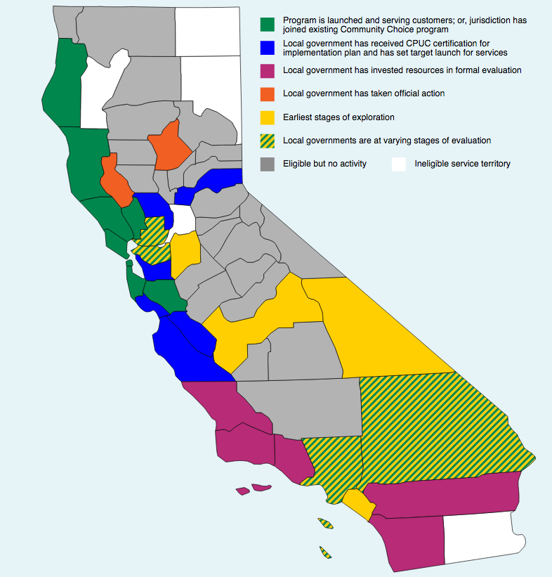
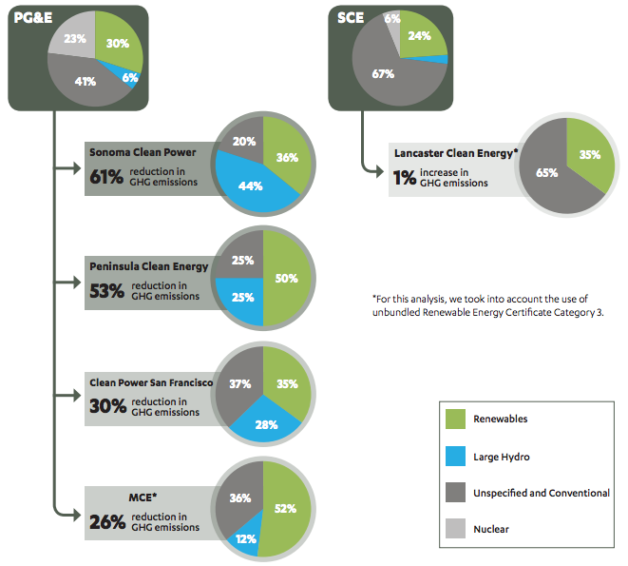
Success across California
Source: UCLA Luskin Center, 2017
Source: Clean Power Exchange

Slide 28
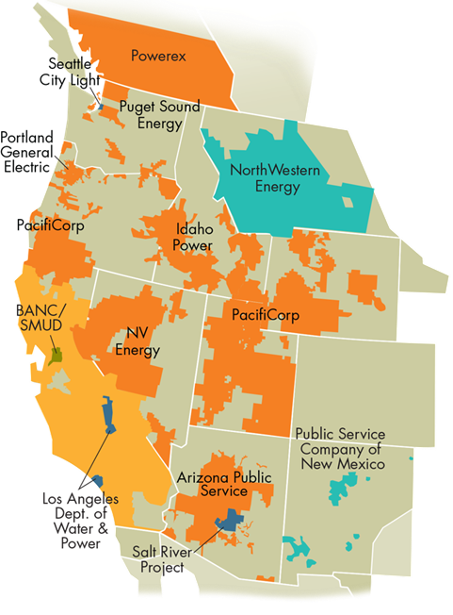
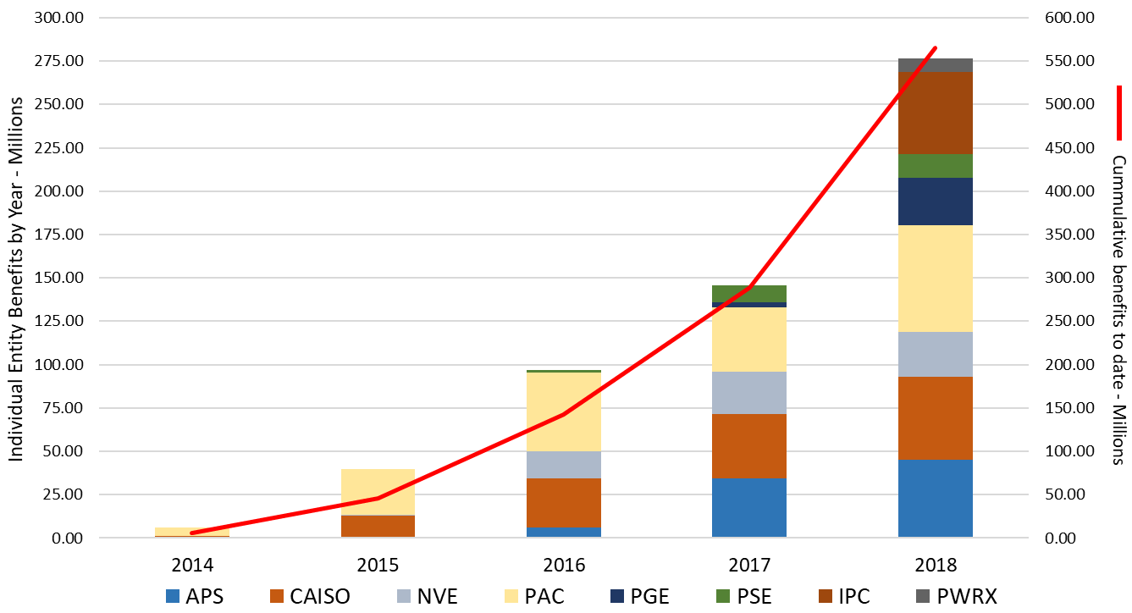
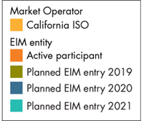
EIM and associated benefits grow
North Western Energy signed implementation agreement – planned entry in 2021.
BANC/SMUD begins parallel operations at midnight, January 31st/February 1st.
Continue to work with BPA in their process towards signing an implementation agreement.
Gross benefits since November 2014
$564.88 million

Slide 29
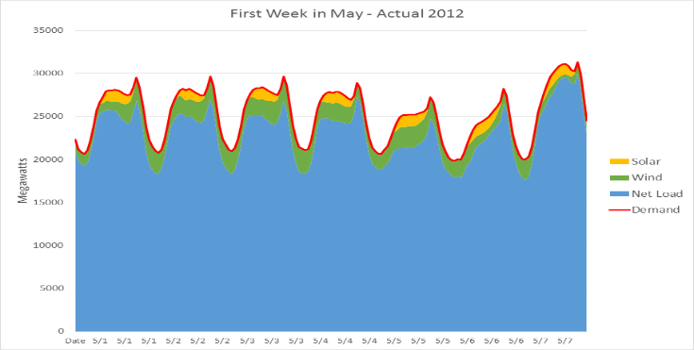
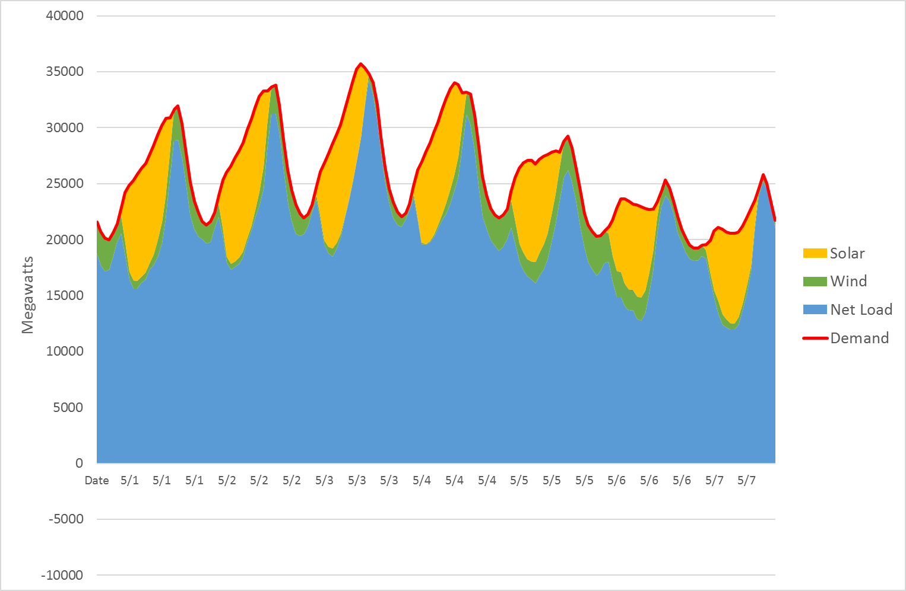
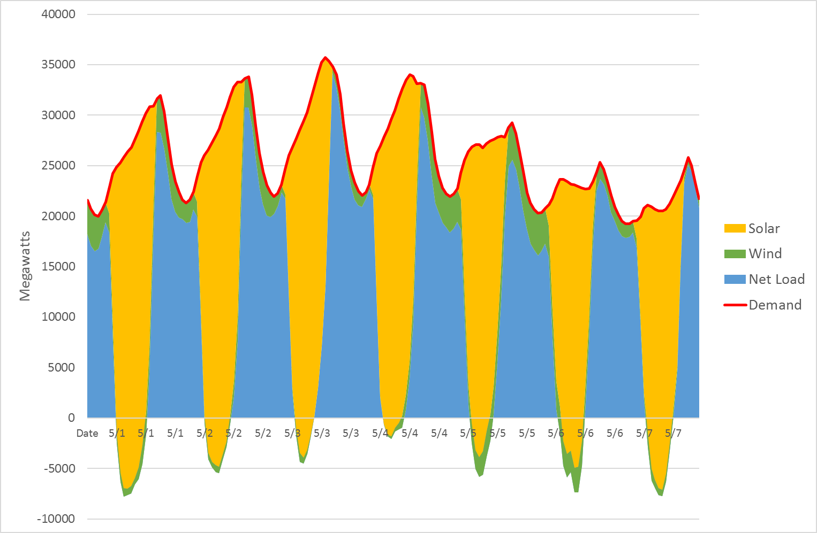
Evolving structure of power supply - California
Huge ramp rates up and down
First week of May
2012 (actual)
First week of May
2017 (actual)
First week of May
2030 (modelled)
Lots of DR, storage and export - or curtailment
No more “baseload”
Source: CAISO OASIS; CEC proposed IRP; LM Power; CESA; Bloomberg New Energy Finance

Slide 30


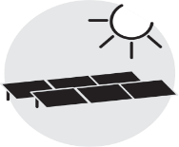






Digitization technologies
Existing technologies driving digitization
Emerging technologies driving digitization
Behind the meter generation
Machine learning and AI
Batteries
DERMS
Cloud storage
Big data
Internet of Things
Blockchain
Home energy management
Smart data
Edge processing
Smart grid
Electric vehicles
Cyber security
Demand response
Virtual power plants
Source: Bloomberg New Energy Finance

Slide 34

A new “Low Carbon Circle”
The future is:
Digitized,
Decentralized,
Decarbonized, and
Democratized
Decarbonize Bulk Grid
Decentralize
Electrify Economic Sectors
Enable sectors to provide grid services
Regionalize for Visibility & Control
= Opportunity for Storage

