Slide 1
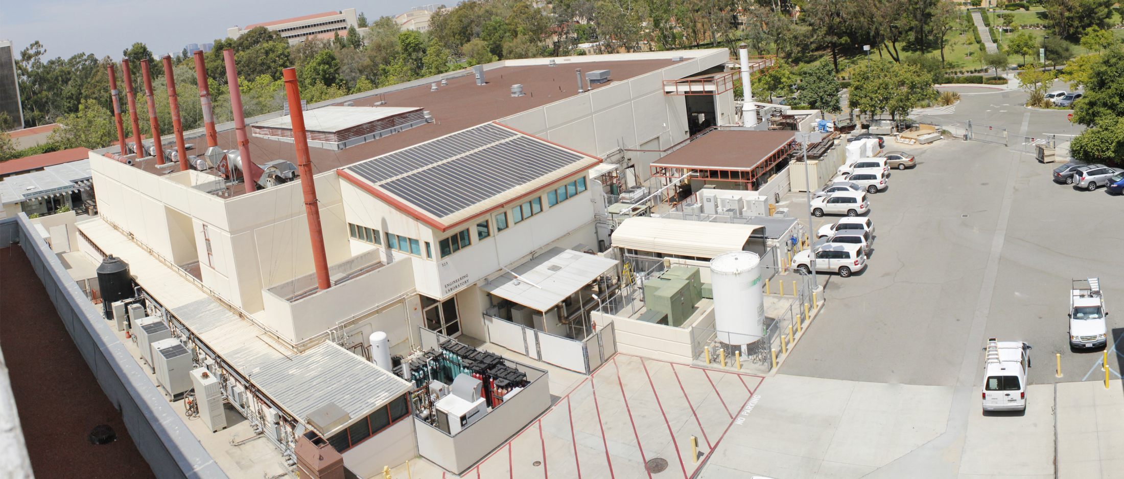
State-of-the-art and Current Challenges in Research and Deployment of Electrolyzers for Hydrogen Generation and Storage 2019 Winston Chung Energy Storage Technologies and Applications Conference - UC Riverside
Iryna Zenyuk, Associate Director, National Fuel Cell Research Center
Jack Brouwer, Director, National Fuel Cell Research Center
University of California, Irvine

Slide 2
Outline
Overview of Drivers for Renewable Grid
Hydrogen economy and H2@Scale
Challenges in cost, durability and efficiency for electrolyzers
Imaging and characterization of electrolyzers for components improvement
Conclusions
Notes:
Decline in average wind prices from about $70 per megawatt-hour in 2009 to $20 per megawatt-hour in 2017, $50 decline in an eight year period.
Bigger turbines enhanced wind project performance, lower turbine pricing to push down installed project costs. DOE reports all low-cost projects are located in US wind belt, 8.5 meters per second.
Wind Power Curtailment. Curtailment of wind project output results from transmission inadequacy and other forms of grid and generator inflexibility. For example, over-generation can occur when wind generation is high but transmission capacity is insufficient to move excess generation to other load centers, or thermal generators cannot feasibly ramp down any further or quickly enough

Slide 3
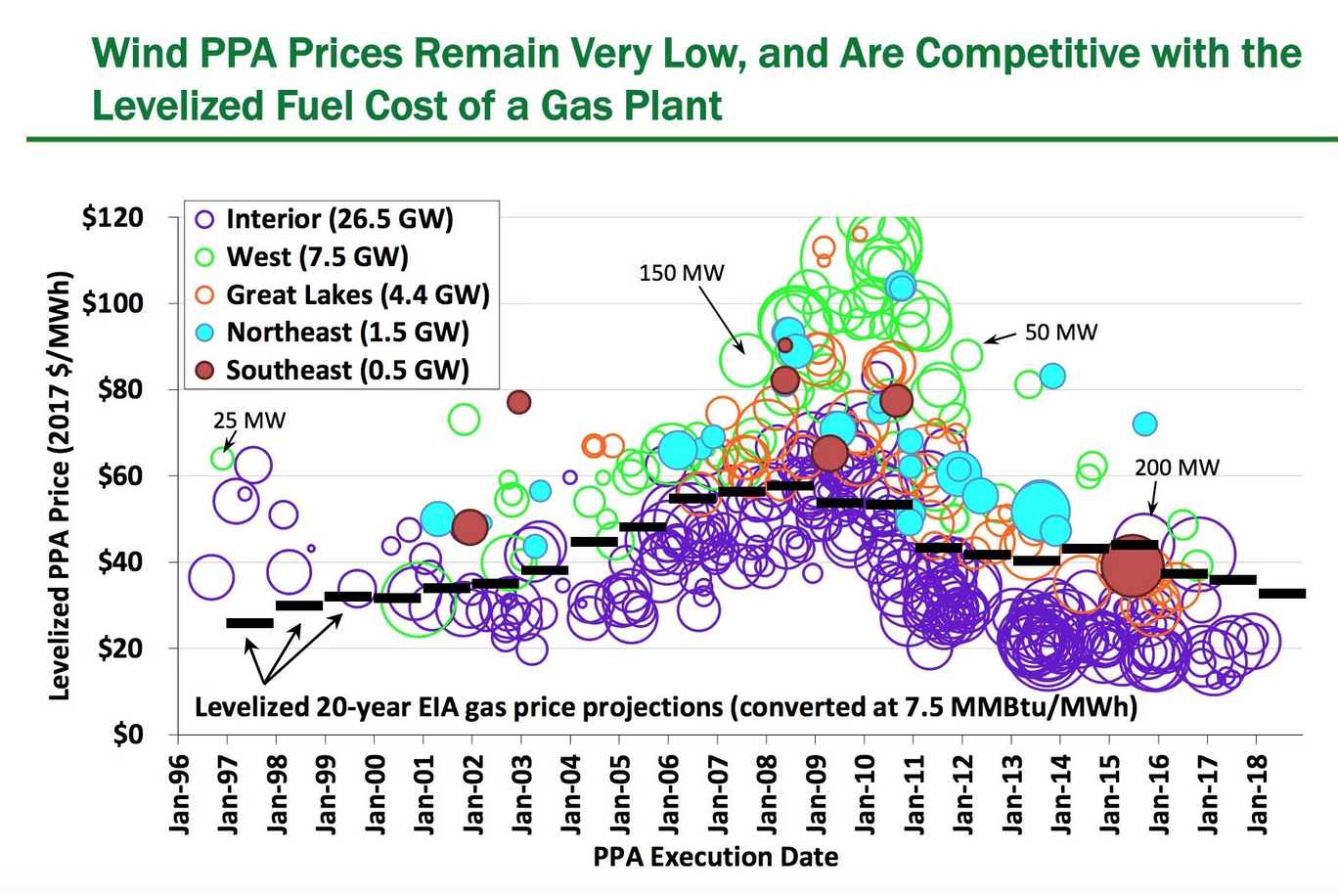
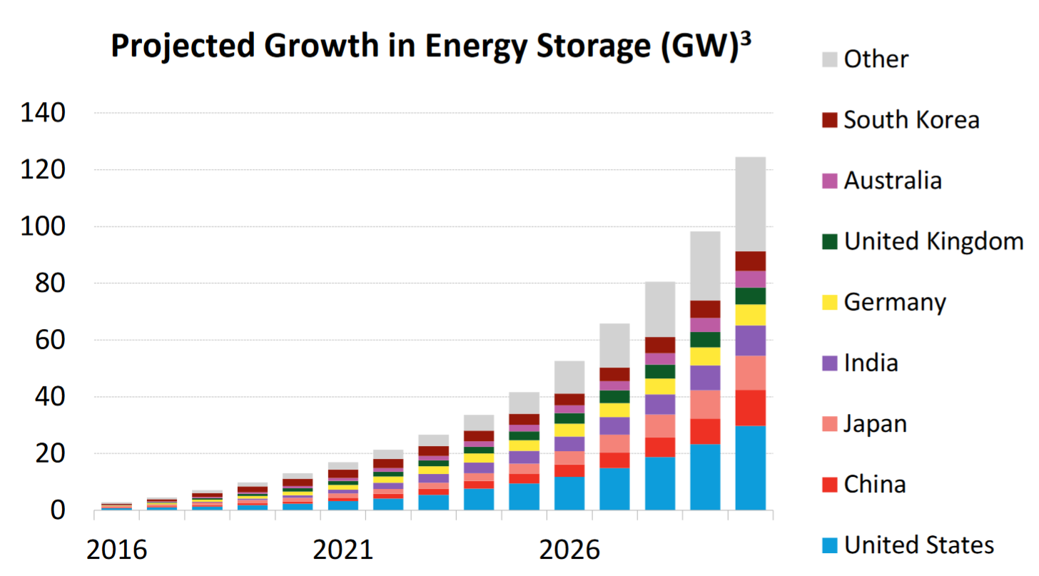
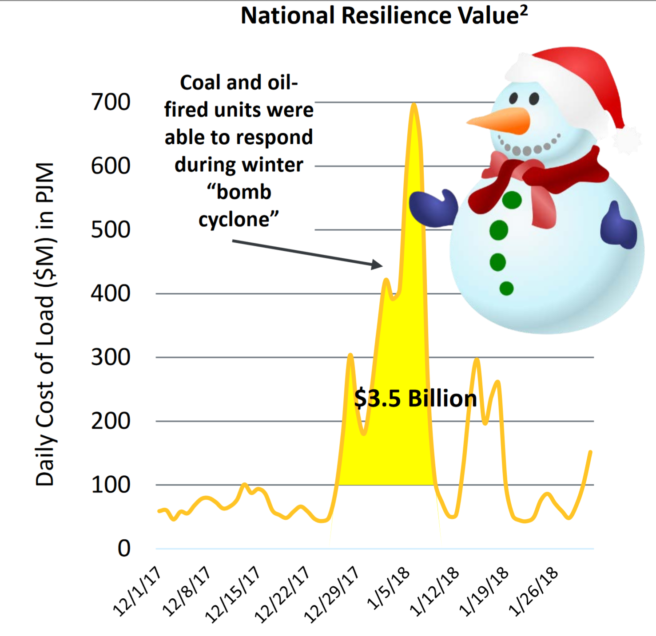
Key Drivers for Evolving Energy System
Increase low-cost, renewable variable electricity
Growth in energy storage
Energy System Security/Resilience
National Resilience Value
Sekine, Yayoi. “2017 Global Energy Storage Forecast”. Bloomberg New Energy Finance.
2017 Wind Technologies Market Report
National Energy Technology Laboratory, https://www.netl.doe.gov/energy-analyses/temp/ReliabilityandtheOncomingWaveofRetiringBaseloadUnitsVolumeITheCriticalRoleofThermalUnits_031318.pd
Notes:
Decline in average wind prices from about $70 per megawatt-hour in 2009 to $20 per megawatt-hour in 2017, $50 decline in an eight year period.
Bigger turbines enhanced wind project performance, lower turbine pricing to push down installed project costs. DOE reports all low-cost projects are located in US wind belt, 8.5 meters per second.
Wind Power Curtailment. Curtailment of wind project output results from transmission inadequacy and other forms of grid and generator inflexibility. For example, over-generation can occur when wind generation is high but transmission capacity is insufficient to move excess generation to other load centers, or thermal generators cannot feasibly ramp down any further or quickly enough

Slide 4
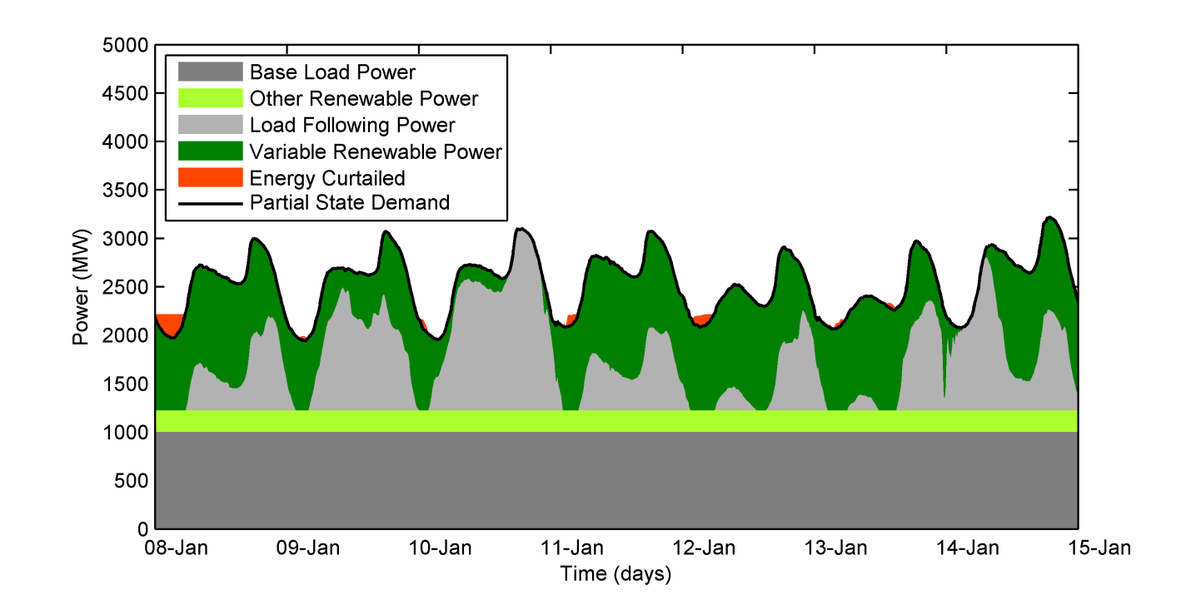
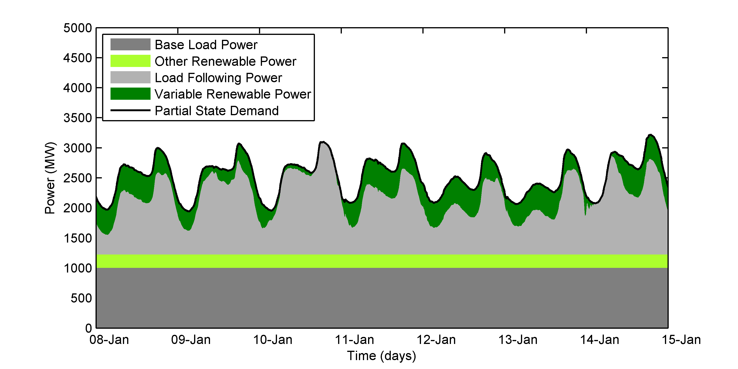
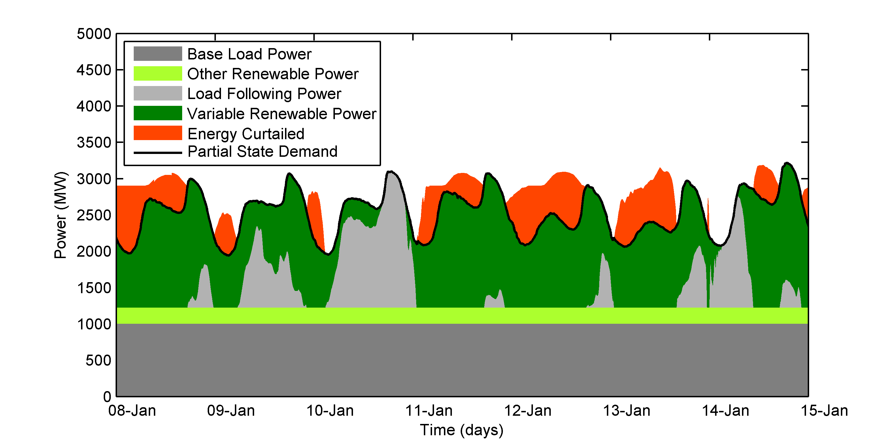
Towards a 100% Renewable Grid
Cost/availability of Solar & Wind make 100% energy amount possible
Renewable Energy and Demand DYNAMICS
Prof. Brouwer group
CASE B: 2020, 33% Renewable, 20% Wind
CASE C: 2030, 50% Renewable
CASE A: 2013 Actual
Notes:
Cal grid simulation done by Jack with HiGRID model (past and future years) Every 15 min
Need energy storage and clean dispatchable generation

Slide 5
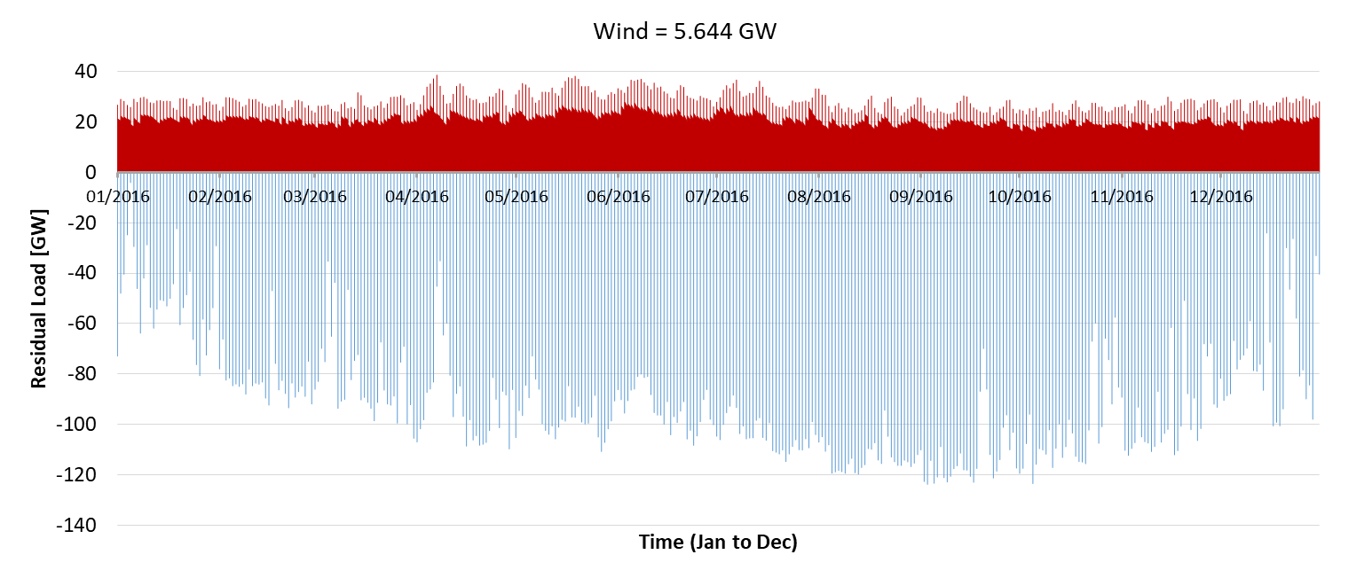
Amount of Storage Required
Recent 1-Year Simulation of 100% Renewable Grid in CA
Mostly Solar power (162 GW solar capacity, 5.6 GW wind capacity)
Deficit
Surplus
Pumped Hydro
Current* H₂ Storage
21 million EVs§
*Using existing natural gas resources for hydrogen storage
Prof. Brouwer group
§ 21 million = total CA registered light duty vehicles; Nissan Leaf battery
Notes:
More renewable generated than consumed in the grid. Size is energy. Depleted oil and gas fields.
33% of grid energy to come fromrenewable generation by 2020, and 50% by 2030

Slide 6
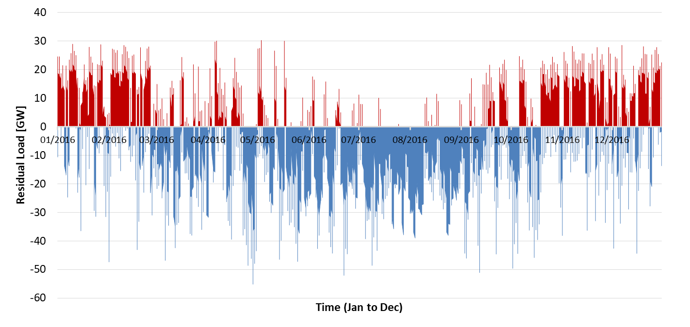
Amount of Storage Required
Recent 1-Year Simulation of 100% Renewable Grid in CA
Wind dominant case (37 GW solar capacity, 80 GW wind capacity)
Deficit
Surplus
Seasonal
Seasonal
Current H₂ Storage
Pumped Hydro
21 million EVs
Prof. Brouwer group

Slide 7
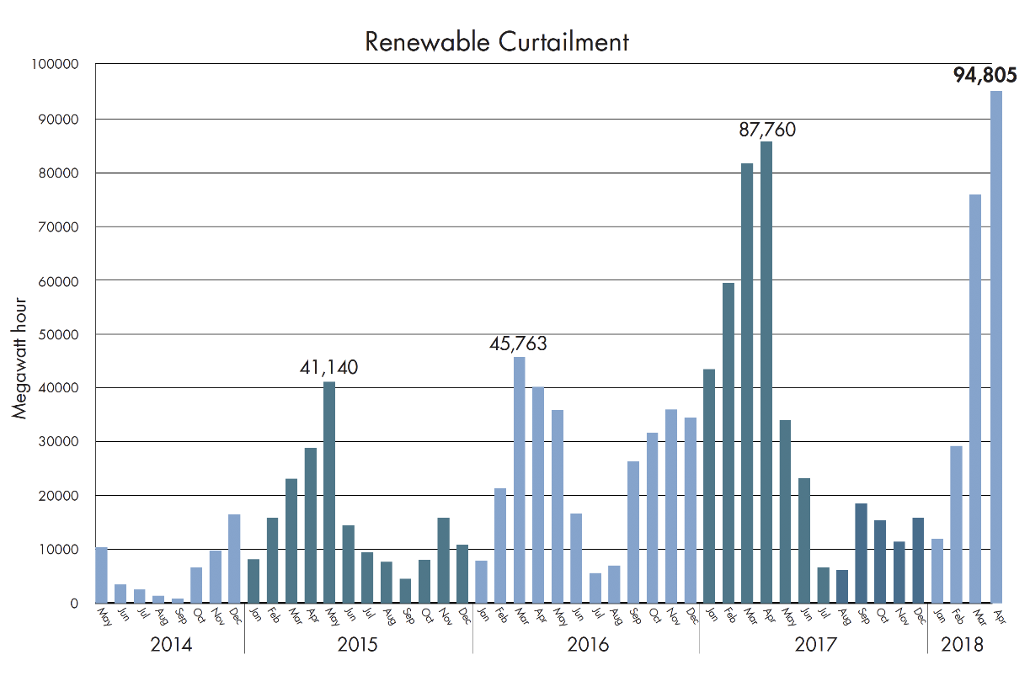
Renewable Curtailment in California
Battery Cost Comparison Case
~450 GWh curtailed in 2017
Future U.S. DOE battery price ($200/kWh)
Seasonal shifting requires: $22 billion Li-Ion battery
Daily shifting requires: $573 million Li-Ion battery
Current electrolyzer cost (actual sale of NEL ASA to H2V PRODUCT in France at $477/kW) – assuming gas grid use
Seasonal shifting requires: $170 million electrolyzer
Daily Shifting requires: $170 million electrolyzer
Gas grid interconnections (10): $12 million
Fuel cell systems for power to grid: $356 million
Total: $538 million
In 2017: 7.4 – 11.1 million kg H₂
34,500 – 51,700 FCEVs (15,000 mi/yr)
Prof. Brouwer group
Notes:
That’s enough to power more than 30 million homes for an hour.
As it stands, California’s system has limited ability to store that power, send it elsewhere, or balance it out with other renewable resources like wind. So the more solar California adds, the less valuable it becomes.

Slide 8
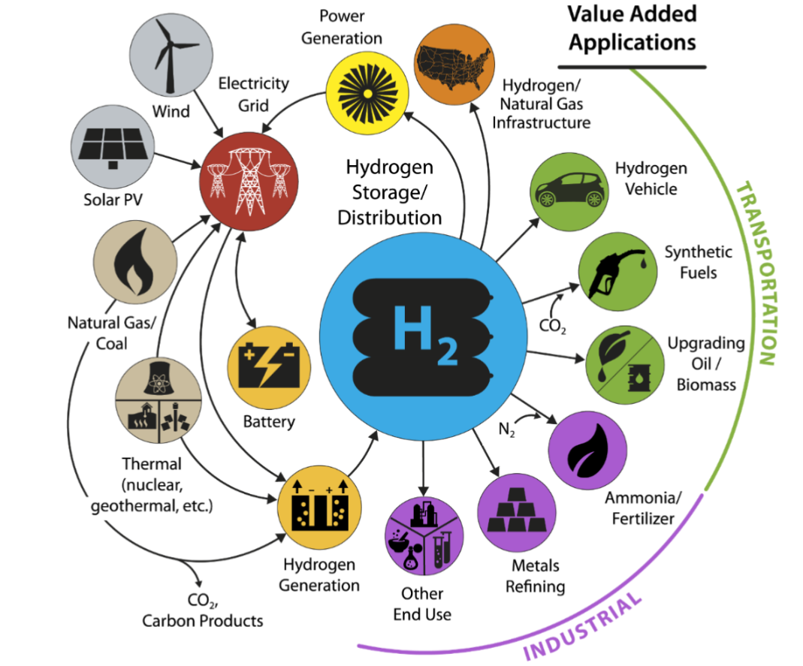
H2@Scale DOE Initiative
Forbes, April 2, 2019:
“… within a couple decades the very best sites will go to 1.5¢ per kilowatt hour cost of electricity. Hydrogen is pretty good, because you can store it in underground caverns and things like that, and the overhead compared to a battery is very compelling.
So it may be that we’ll move to a partial hydrogen economy based on renewable energy," Chu said in an appearance hosted by the Energy Policy Institute of Chicago

Slide 9
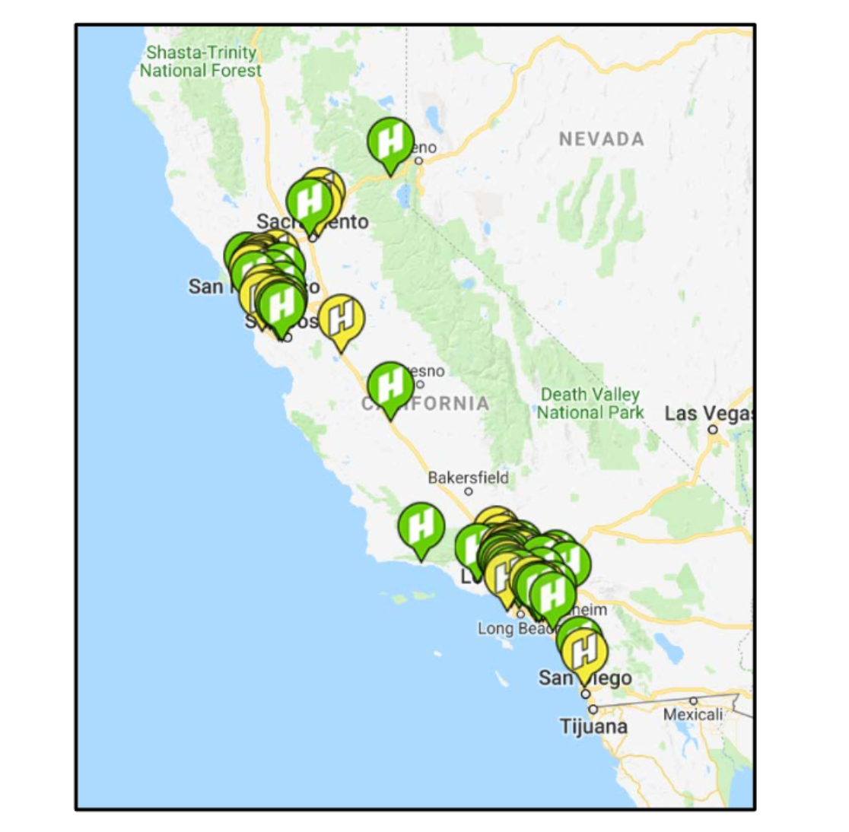
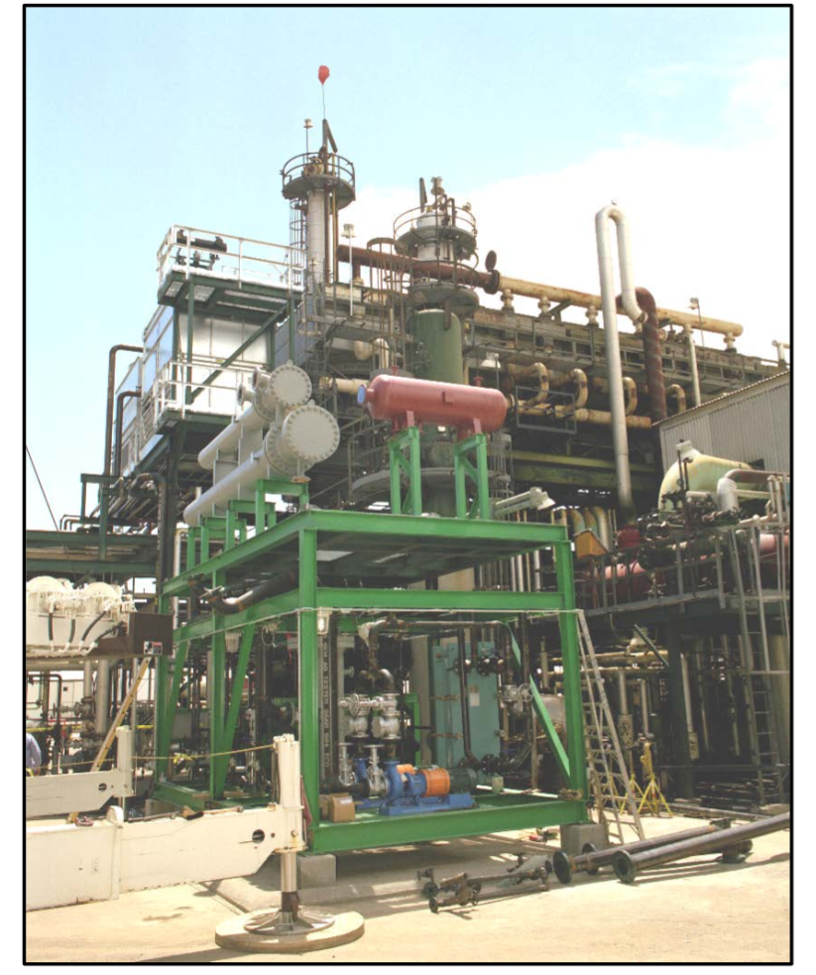
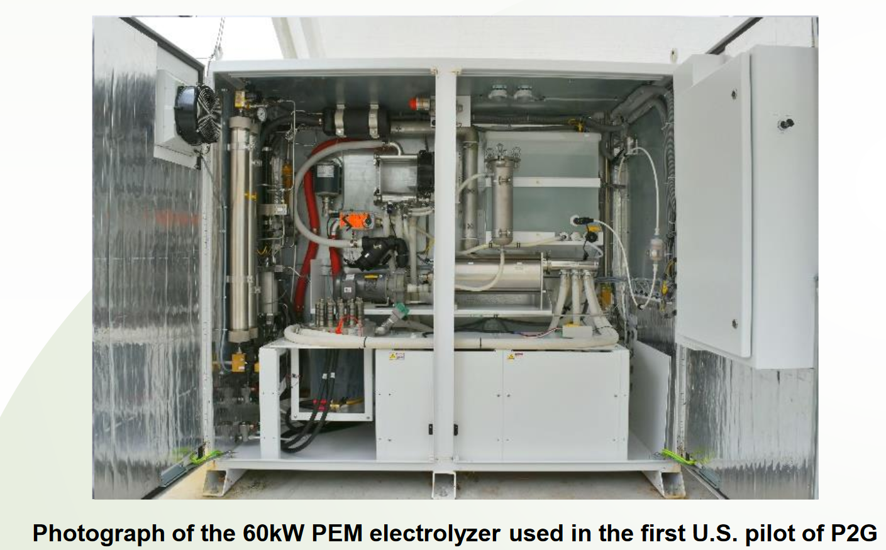
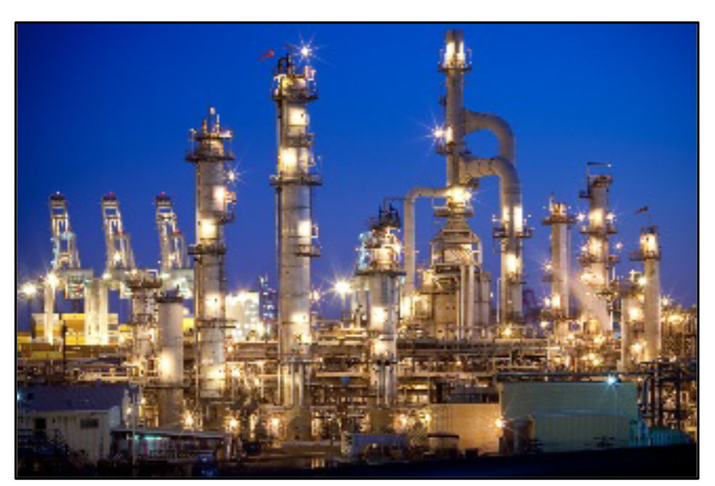
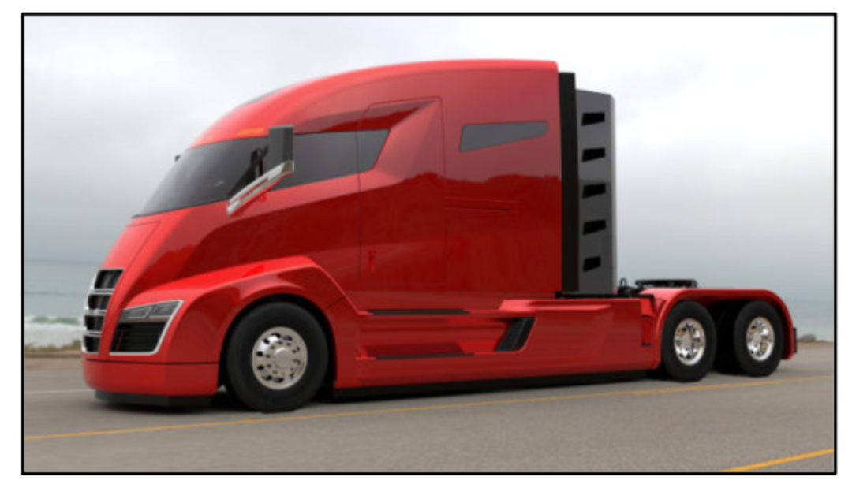
Examples H2@Scale and Electrolyzers
Integration of 6 MW of electrolysis with wind energy and natural gas pipelines (2015; Mainz, EnergiePark Mainz)
~5000 Fuel Cell Vehicles and 35 H₂ fueling stations open in CA
UCI have built and are evaluating the first U.S. integrated power-to-gas (P2G) pilot that uses a 60kW PEM electrolyzer system with natural gas pipeline injection followed by combined heat and power production.
750,000 ton/year ammonia plant using by-product hydrogen opens in Freeport, TX (2018; Yara, BSF)
1000 kg/day H₂ stations to be deployed in 14-28 locations for fuel cell trucks (2018; Nicola, NEL)
Integration of 10 MW of electrolysis with Rheinland Refinery Complex (Germany), (2018; Shell)
Notes:
Project Sponsors:National Fuel Cell Research Centerwww.nfcrc.uci.eduGOALS•Demonstrate load following of solar and wind electricity resources with PEM electrolyzer systems through direct connection to the resource, and through load following signals.•Integrate a PEM electrolyzer system with high pressure injection and blending with natural gas to power a combined cycle power plant. Assess any deviations in plant behavior.•Evaluate dynamic capabilities of PEM electrolyzer systems.•Identify and analyze possible modifications to PEM electrolyzer systems to improve performance for P2G application.OVERVIEWA 7kW proton exchange membrane (PEM) electrolyzer is connected directly to solar photovoltaic panels to evaluate dynamic capabilities of such systems and assess performance gains associated with utilizing DC-DC power electronics.We also have built and are evaluating the first U.S. integrated power-to-gas (P2G) pilot that uses a 60kW PEM electrolyzer system with natural gas pipeline injection followed by combined heat and power production. We are investigating both the dynamic capabilities of PEM electrolyzer systems when load following variable renewable energy resources, and the impacts of blending hydrogen into the natural gas fired combined cycle plant

Slide 10
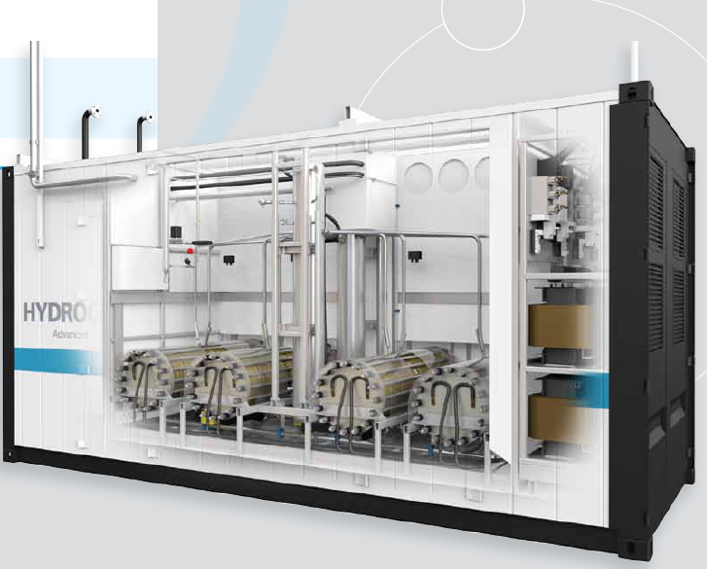
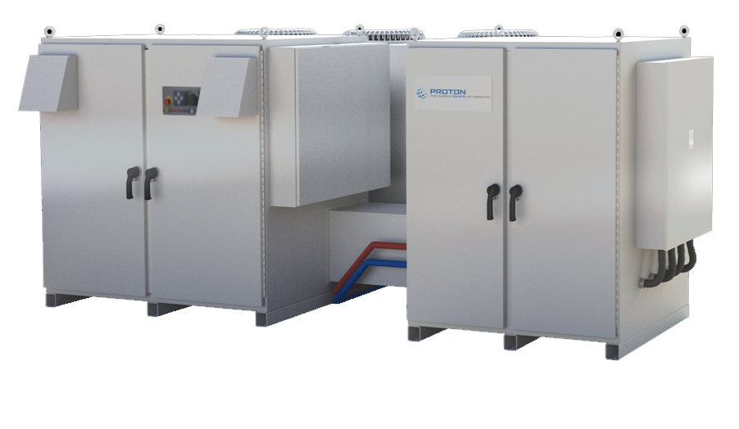
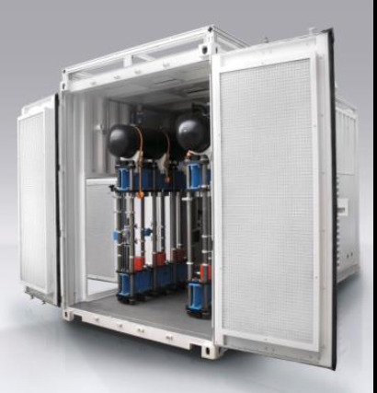
Electrolysis – A Flexible Load
Electrolyzers (PEM, alkaline) produce hydrogen & oxygen from water
Provide load when wind or solar would otherwise be curtailed
Fast response allows for use with variable input (<2 sec)
Fast response can provide other ancillary services (e.g., regulation, Volt/VAR support)
Sizes range from 10’s of KW to several MW (today)
Cell efficiency up to 90 % (HHV)

Slide 11
PEM Electrolyzers State-of-the-Art and Challenges
PEM Targets: Cost, Durability and Efficiency:
Membranes (Nafion 117, thick = large Ohmic drop)
Gas crossover (5000 psig H₂ pressures)
Catalyst Materials (IrOx and other PGM-metals)
Catalyst Loadings (need for catalyst support)
Porous transport layer (PTL) materials (currently sintered Ti)
Additional Barriers:
Material integration
Material cost
Understanding interfaces
Cathode
Anode
2H⁺+2e⁻→H₂
H₂O →1/2O₂+2e⁻+2H⁺
H₂
cMPL/cGDL cCL PEM aCL aPTL
O₂
Diffusion
Electro-osmosis
Oxygen evolution
H₂O
State-of-the-art PEM
2V @ 2 A/cm²
2-3 mg/cm2 PGM catalyst loading on anode and cathode
60-80k hours in commercial units
$3.7/kg H₂ production
https://www.hydrogen.energy.gov/pdfs/review18/pd148_bender_2018_o.pdf

Slide 12
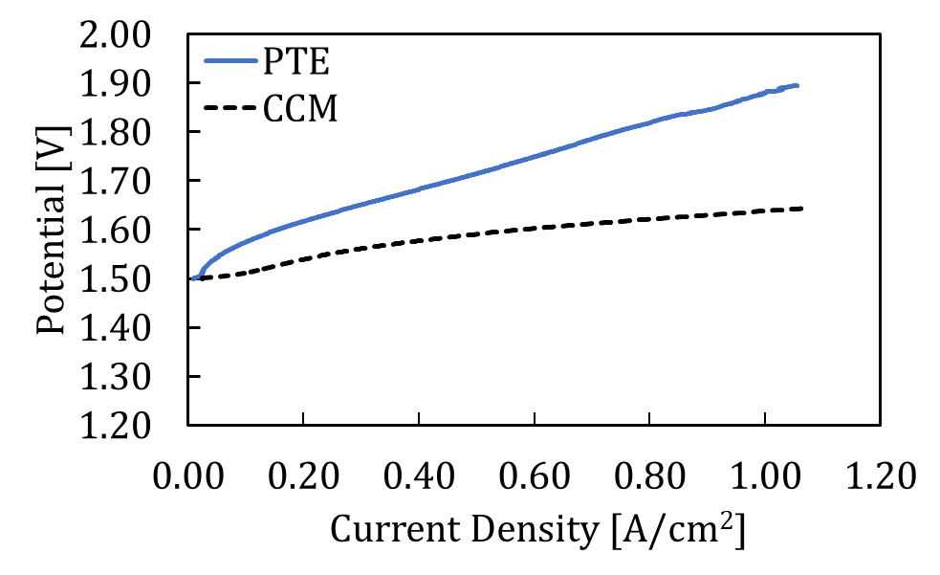
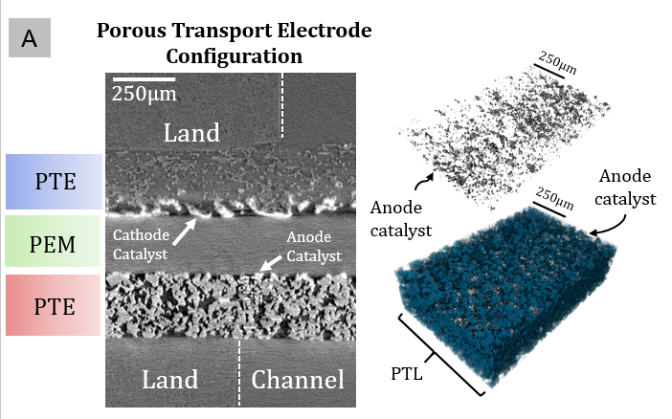
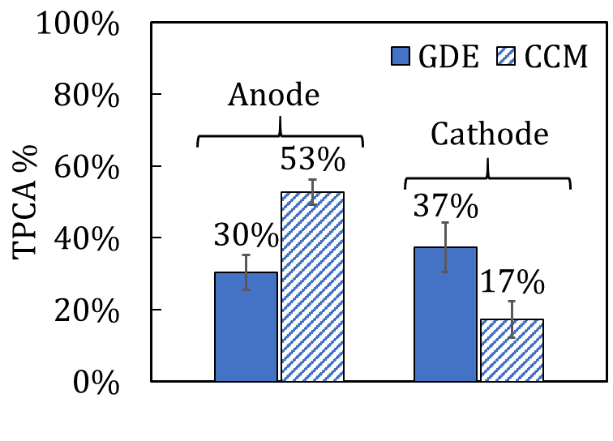
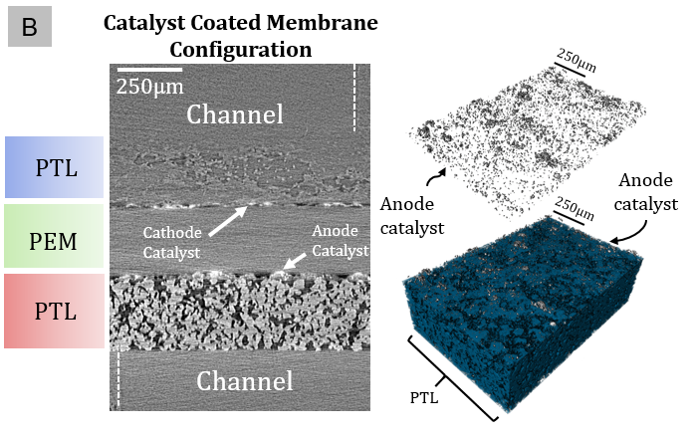
Operando X-ray CT to Characterize Interfaces
Operando X-ray CT of CCM vs PTE:
Tomography reveals morphology of interfaces
Higher number of triple phase boundaries (TPB) for CCM compared to PTE for anode (higher loading in cathode)
Better catalyst utilization for CCM
Isolated electrocatalyst islands vs continuous layer
Operando cell at beamline

Slide 13
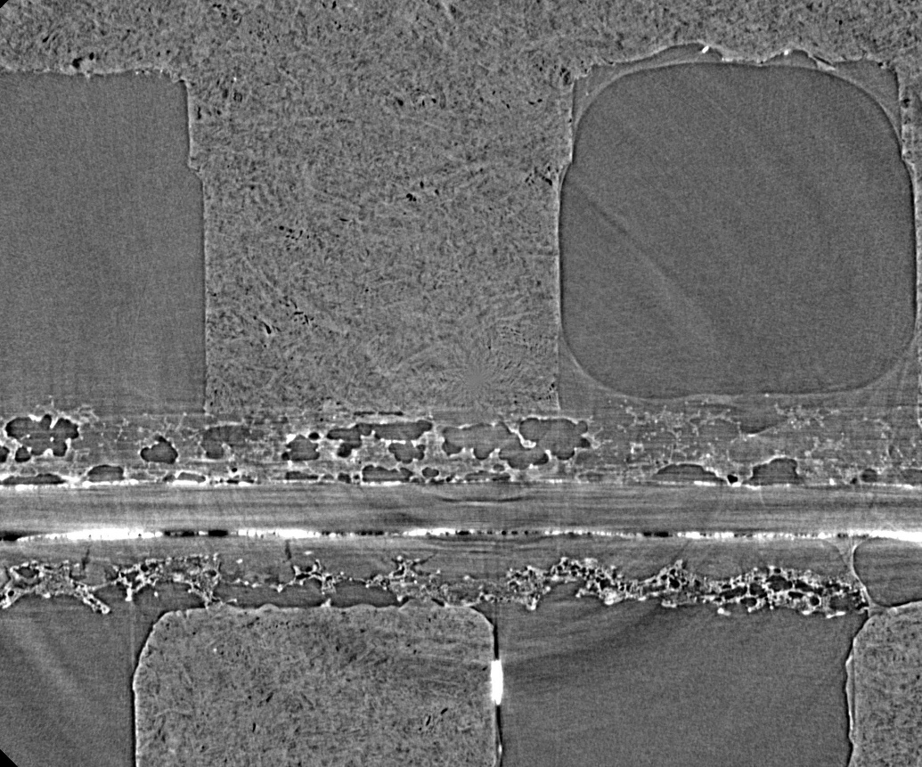
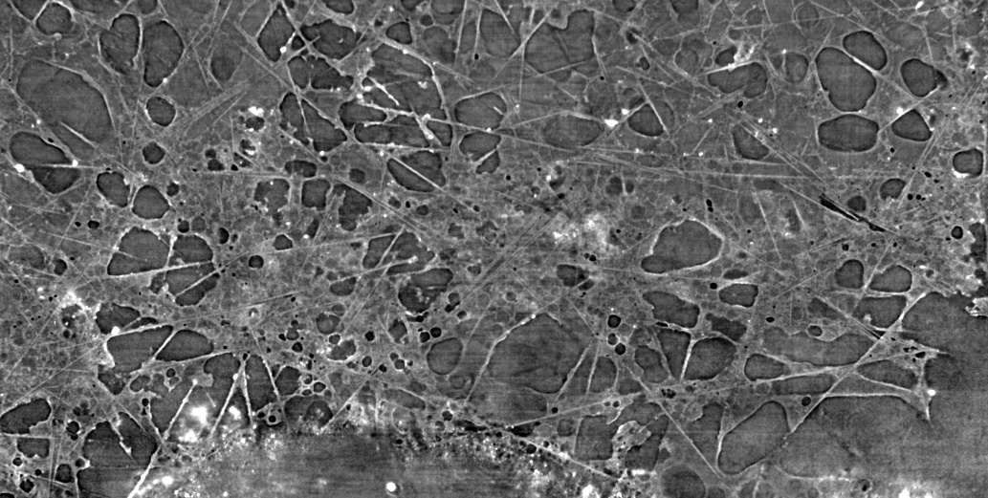
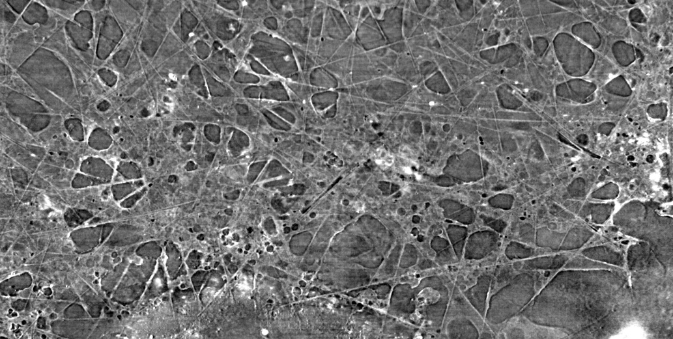
Electrocatalyst Mechanical Degradation during OER
50 mA
200 mA
Bubbles formation leads to high mechanical stress in the catalyst layer (iridium ruthenium oxide)
Observed mechanical degradation of catalyst layer and catalyst deposition in the PTL
Tomography captures time-average representation but not dynamics
Land
Channel
Anode
PEM
Cathode

Slide 14
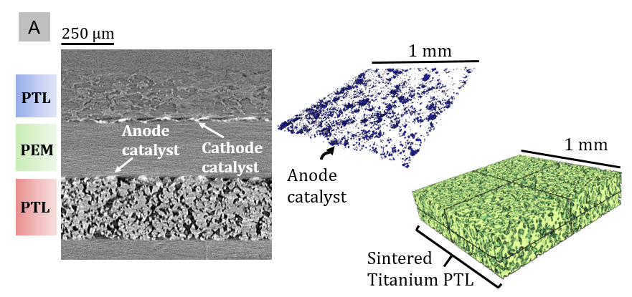
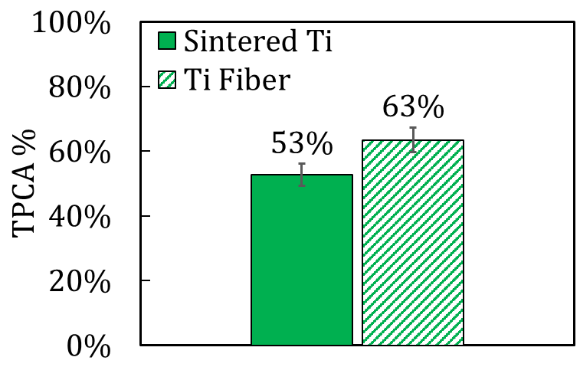
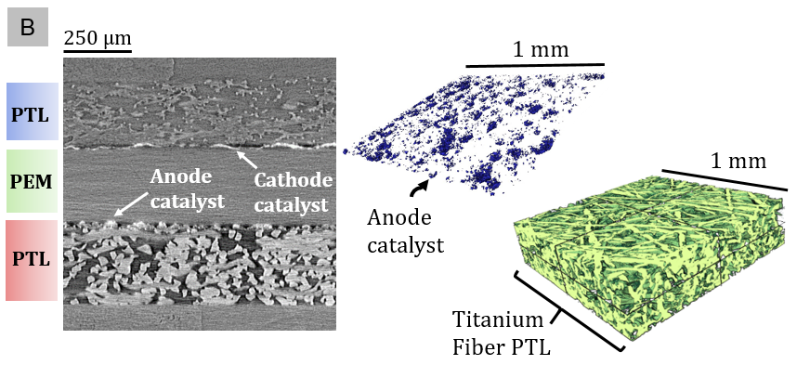
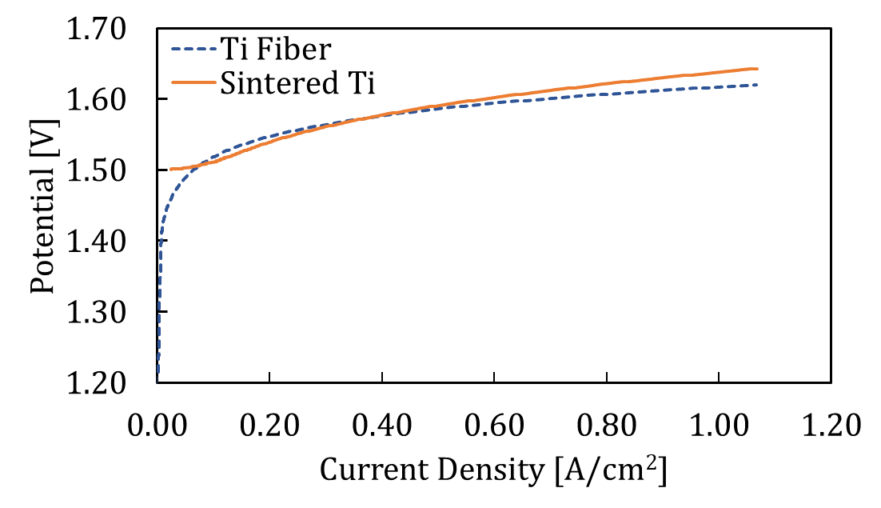
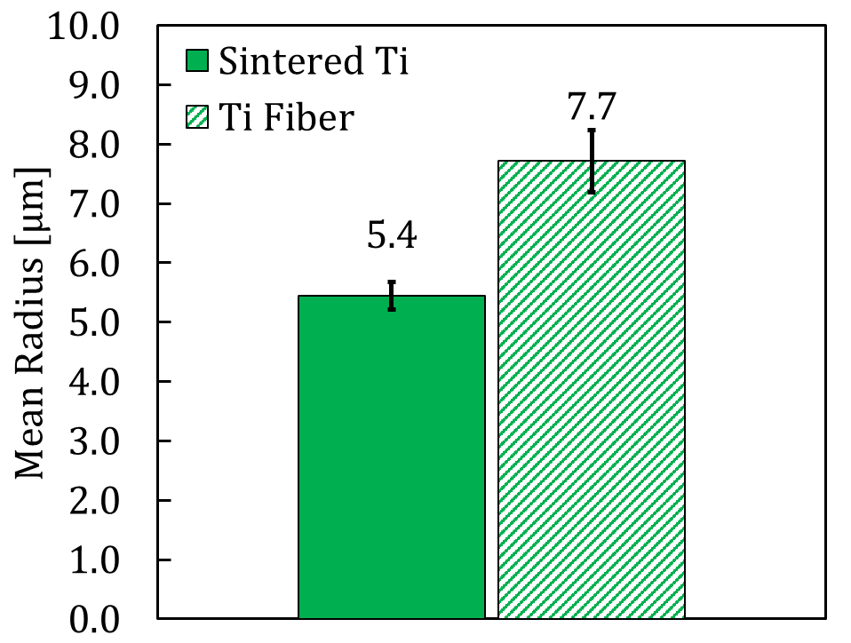
Various PTLs for Improved Oxygen Transport
Operando X-ray CT of Sintered vs Fibrous PTLs:
Similar polarization behavior from operando X-ray CT
Larger pore-size for Ti fiber PTL compared to sintered
Higher porosity for Ti fiber compared to sintered PTL but similar tortuosity factors
Better contact with PTL for Ti fiber

Slide 15
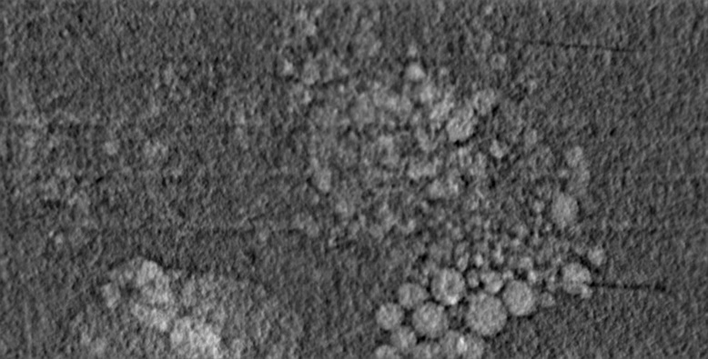
Oxygen Evolution Dynamics: Variations with Flow-rate
OCV
Radiography
50 mA
500 µm
200 mA
Smaller bubbles
Pockets of oxygen
Channel Land Channel
100 mA
Larger bubbles
200 mA
Slug
500 µm

Slide 16
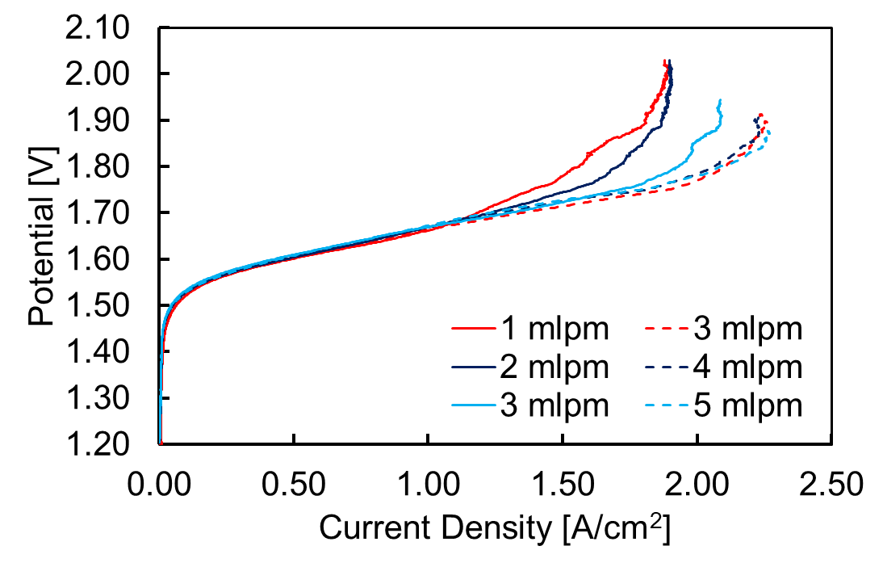
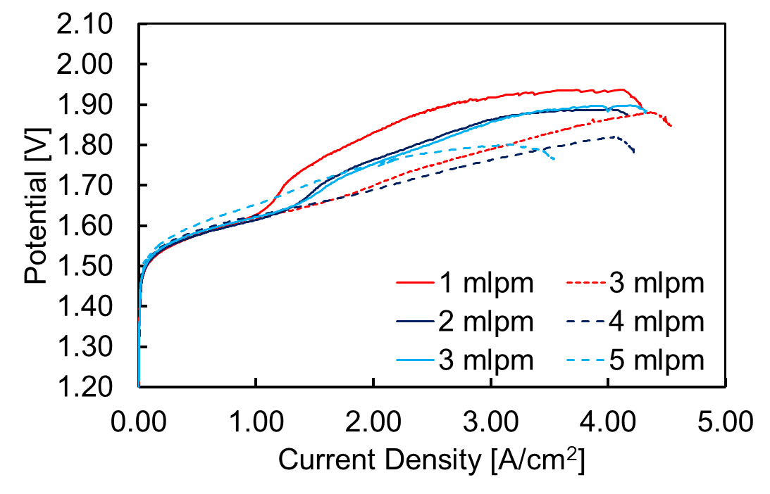
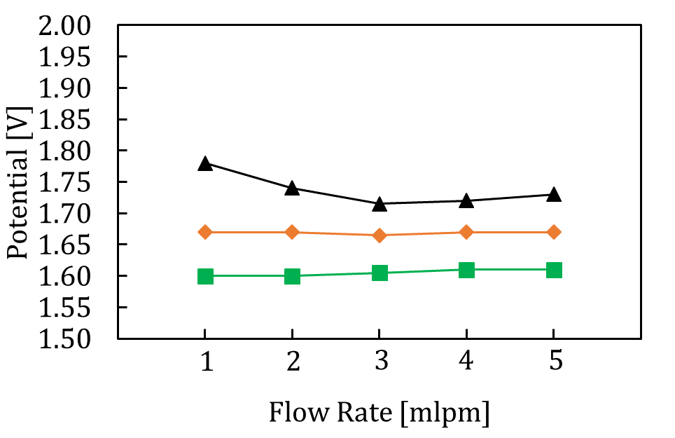
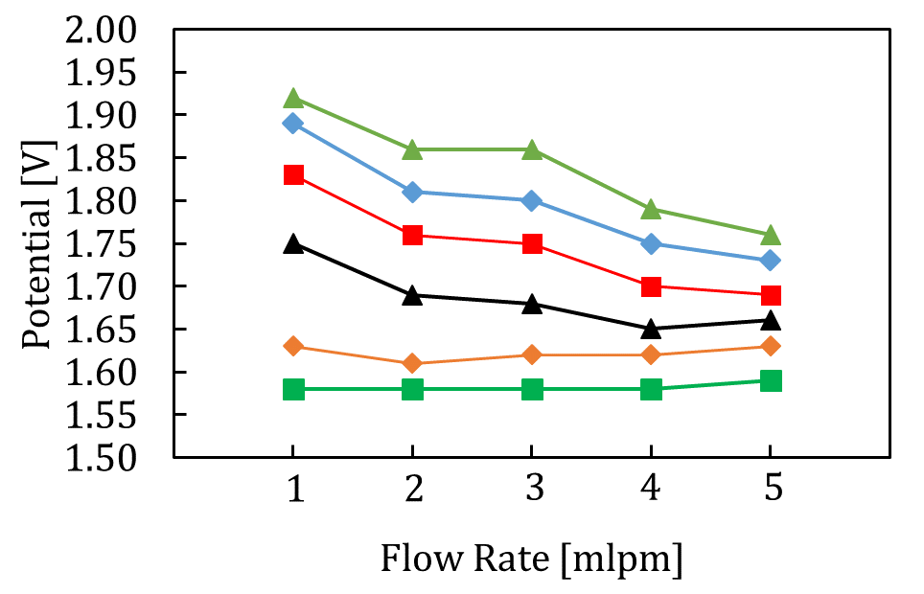
Flow-rate Effects on Efficiency
Using Radiography Observed Oxygen in Channel:
Achieved current densities higher than 4 A/cm² with 1 cm² active area operando X-ray CT cell
Polarization has flow-rate dependency after 1 A/cm² especially during break-in
At higher current densities larger content of oxygen in channels results in higher polarization (lower efficiency)
50ºC, iR corrected
At 2 A/cm²
Water residence time in channel (100- oxygen residence in channel)
Flow-rate [slpm]
Flow-rate [slpm]

Slide 17
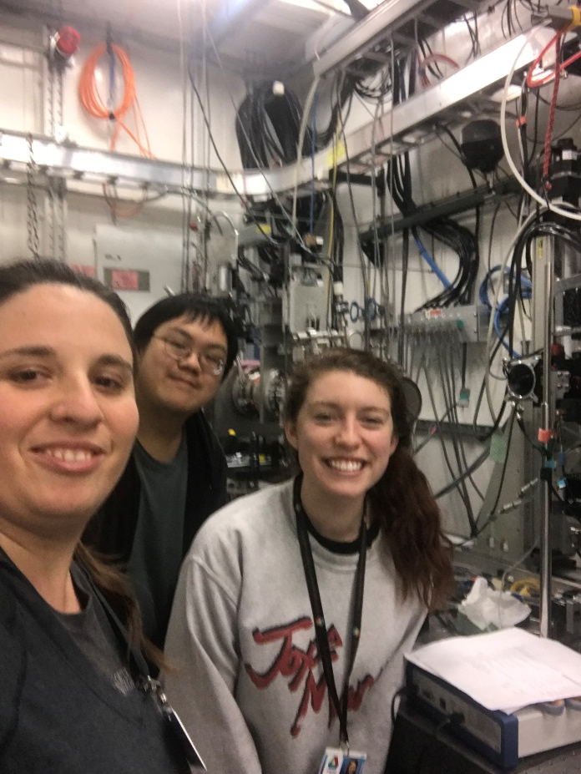
Conclusions and Acknowledgements
Hydrogen economy is desirable for H₂ storage/transmission due to high capacity and long discharge time
Electrolyzers provide load when wind or solar would otherwise be curtailed
With imaging and electrochemical characterization electrocatalyst distribution, oxygen distribution can be correlated to electrolyzer efficiency (polarization)
Design of interfaces is critical
Andrew
Emily
PhD students: Emily Leonard, Dinesh Sabarirajan, Andrew Shum
Proton OnSite (NEL): Kathy Ayres and Chris Capuano
LBNL (former NEL): Nemanja Danilovich and Adam Weber
APS: Dr. Xianghui Xiao
ALS: Dr. Dula Parkinson
AvCarb: Reyhan Tespinar
Flow-rate [slpm]

